Slide 1

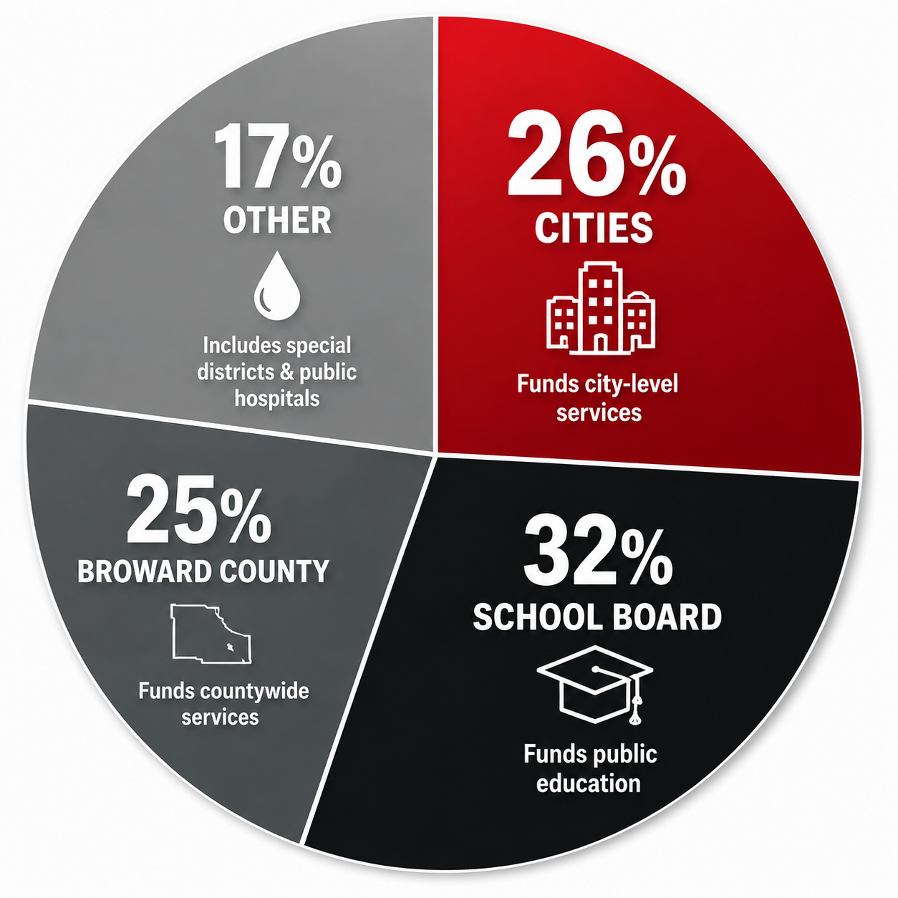

a
THE IMPACT OF
AMENDMENT 3
ON THE MATH OF THE CITY OF
A FACTUAL LOOK AT HOW AMENDMENT 3 COULD AFFECT LOCAL REVENUES AND SERVICES
Amendment 3, if approved by 60% of Florida voters, would expand the homestead property tax exemption and create a framework to reduce or eliminate the non-school portion of property taxes on homesteaded property over time.
THE MATH BEHIND AMENDMENT 3
YOUR CITY AT A GLANCE
Municipal property tax revenue is based on taxable property value and the municipality's adopted millage rate.
ANNUAL PROPERTY TAX REVENUE
$47.5 million
Increase In Homestead Exemption
Lower Taxable Value on Homesteaded Property
Less Property Tax Revenue for Cities
Potential Impact On Local Services
PERCENTAGE SHARE OF THAT REVENUE
SPENT ON PUBLIC SAFETY
70%
PROJECTED ANNUAL REVENUE LOSS IN
YEAR ONE IF AMENDMENT 3 PASSES
WHERE MUNICIPAL REVENUES COME FROM
$ 3,481,239
Property taxes make up the largest single source of revenue for most cities.
PROJECTED ANNUAL REVENUE LOSS IN
YEAR TWO IF AMENDMENT 3 PASSES
Charges for services
Intergovernmental revenues
Fees and other legally available revenues
Property taxes
Sales and use taxes
Franchise Fees
$4,262,239
A reduction in property tax revenue cannot be fully offset by other revenue sources without difficult choices.
WHO RECEIVES BROWARD COUNTY PROPERTY TAXES?
THE IMPACT ON MUNICIPAL BUDGETS
KEY FACT
Because each municipality has a different tax base, population, and service demands, impacts will vary. However, cities may face difficult decisions such as:
Approximately 26¢
of every Broward property-tax dollar
Reducing staffing levels
Delaying infrastructure and facility projects
Cutting programs and services
Deferring maintenance and repairs
Relying on reserves (one-time funds)
Increasing fees or other revenue sources
funds city-level services.
“Other” includes: Children’s Services Council, Public Hospital Districts, South Florida Water Management District, Florida Inland Navigation District and Other Special Taxing Districts
Countywide FY25 tax levy distribution- Educational Overview
Source: Broward County FY26 Budget Brochure; shares based on FY25 tax levies.
SERVICES AT RISK
PUBLIC SAFETY
INFRASTRUCTURE
PARKS & RECREATION
CULTURAL SERVICES
TRANSPORTATION
OTHER SERVICES
Police, fire, EMS, emergency response
Roads, sidewalks, drainage, utilities
Parks, trails, recreation centers, programs
Libraries, museums, arts programs
Shuttle services, trollies, paratransit
Golf courses,
beaches, pools,
special events
EDUCATIONAL PURPOSE ONLY
Factual, nonpartisan educational material. Local figures should be verified against the municipality's adopted budget, taxable-value data, and applicable official fiscal estimates.

