Slide 1
The Timeline
Delegate Meeting – 04/13/2021

Slide 2
Memorandum of Understanding

Slide 3
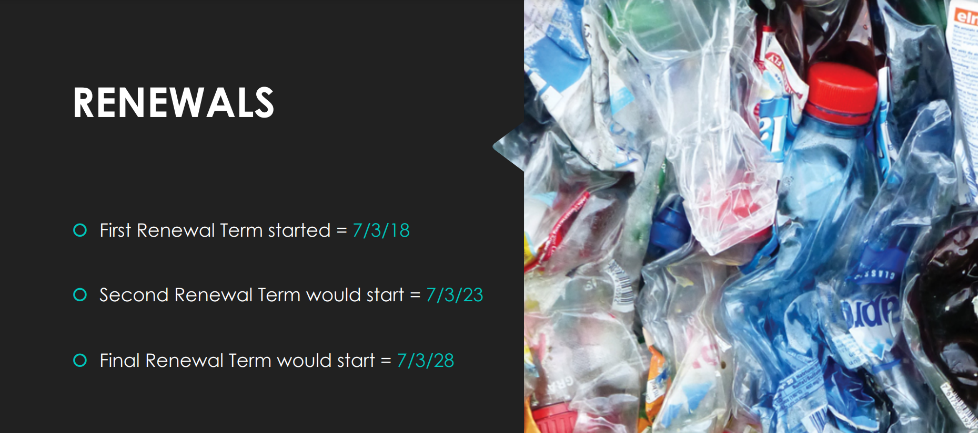

Slide 4
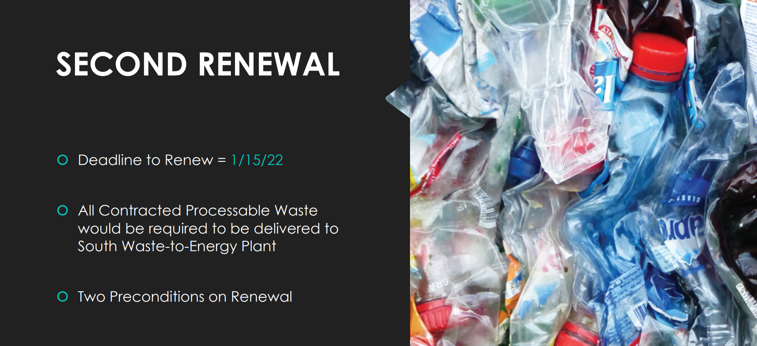

Slide 6
The Need

Slide 7
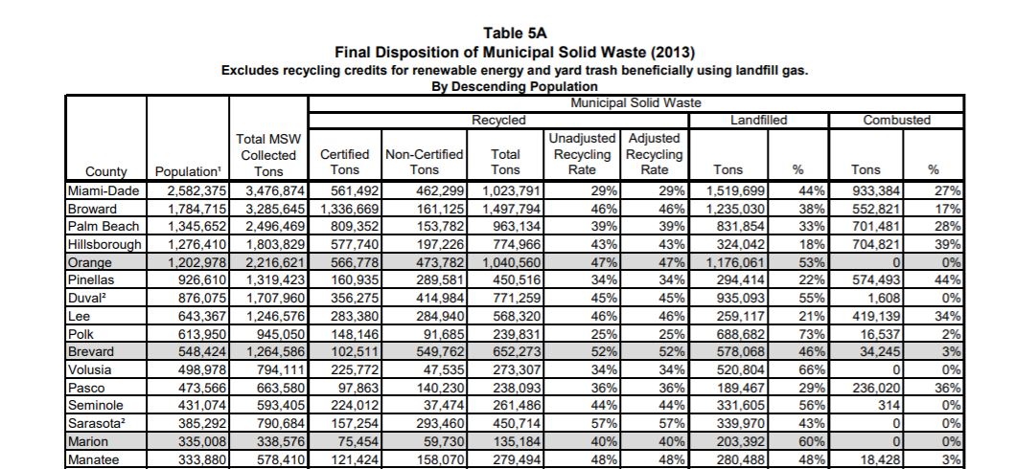

Slide 8
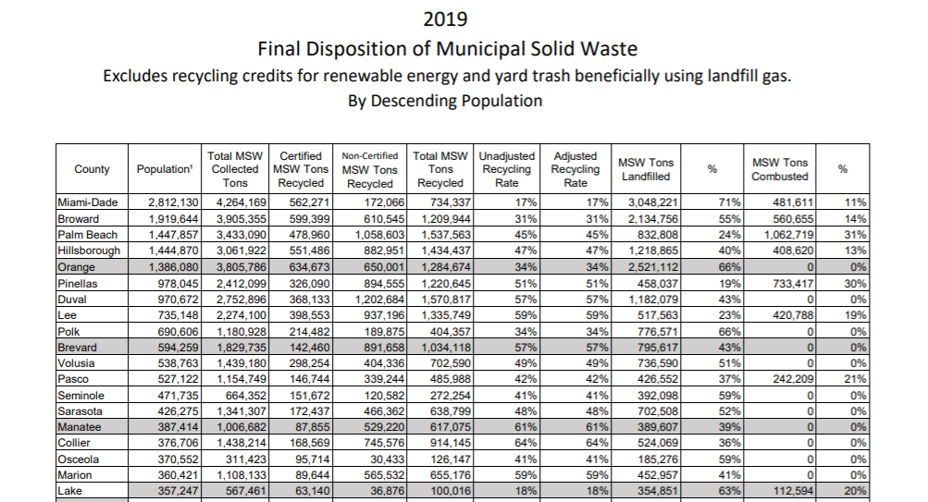

Slide 9
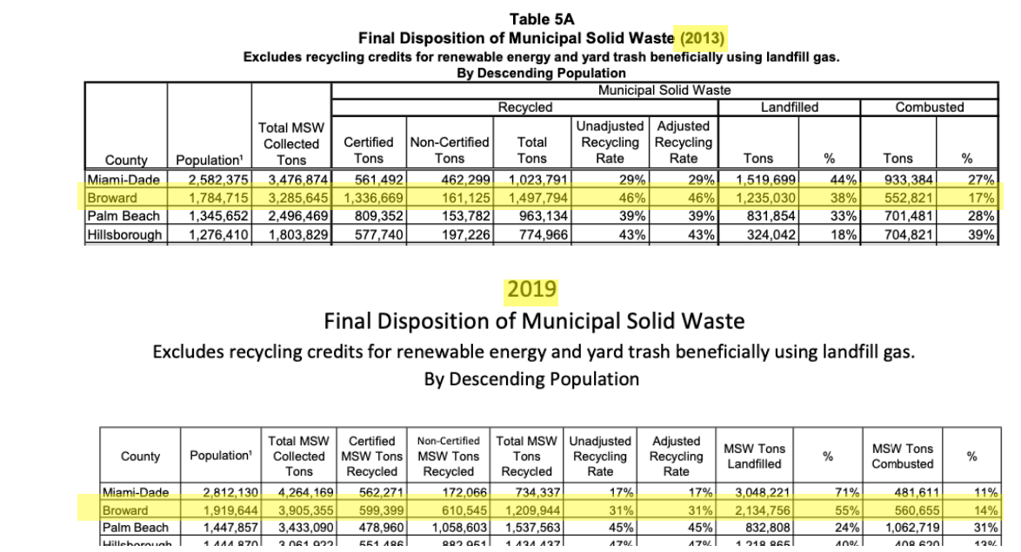

Slide 10
The Cost

Slide 11
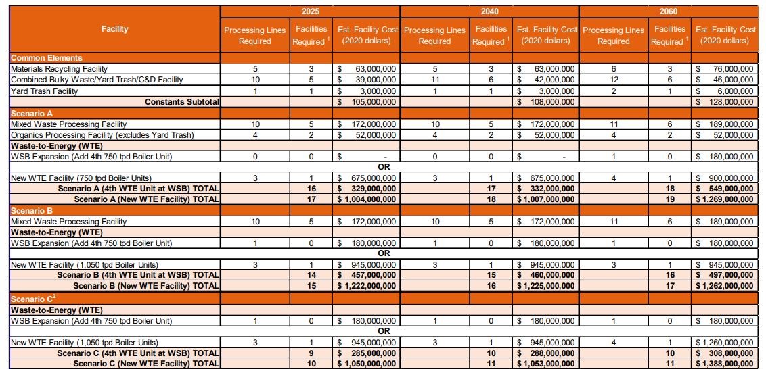

Slide 12
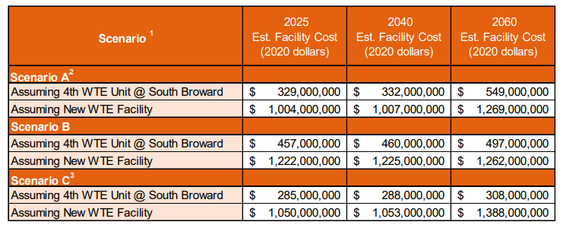

Slide 13
The Assessments

Slide 14
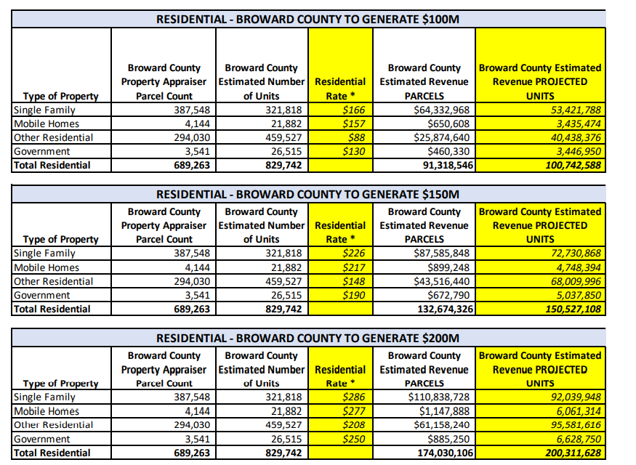

Slide 15
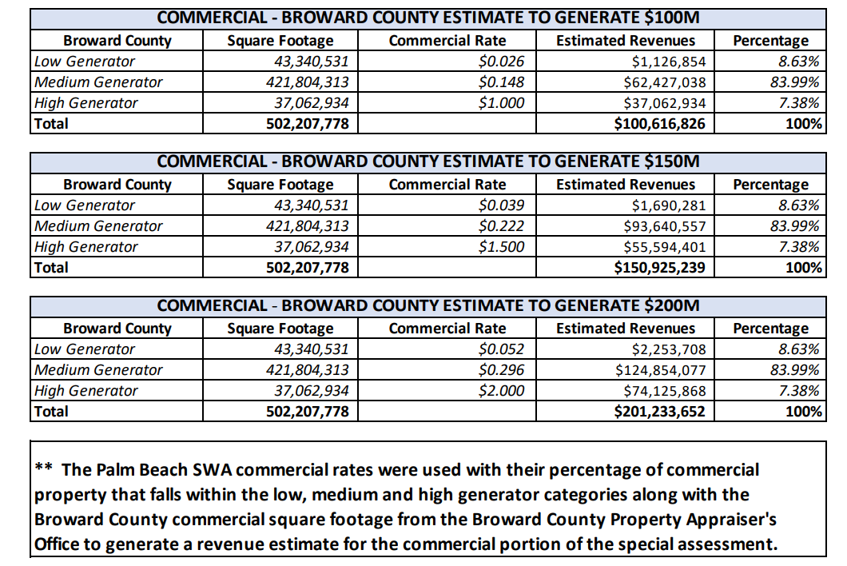

Slide 16
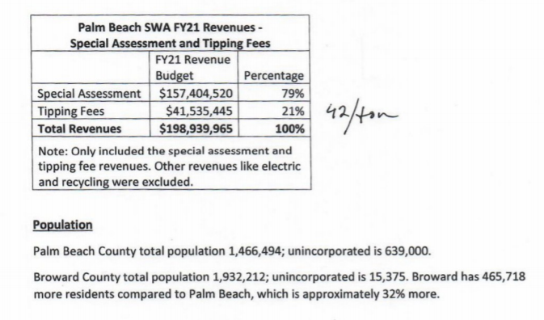

Slide 17
Benefits and Drawbacks of Solid Waste Governing Structures

Slide 18
Interlocal Agreement
Benefits
Drawbacks
Meets criteria in terms of timeline, money raised, and capabilities.
Local control over all elements after legal entity is formed.
Flexibility in structure and composition.
Can levy appropriate assessments.
No restrictions on facilities, debt, or structure if created properly.
Requires cooperation and communication between all parties – trust is key.
Less historical examples in Florida of raising required amount of money for new capital projects.
Cannot levy taxes, though can levy assessments.
Not all cities required to join.

Slide 19
Dependent Solid Waste District
Benefits
Drawbacks
Meets criteria in terms of timeline, money raised, and capabilities.
Local control over all elements.
Flexibility in structure and composition.
Can levy appropriate assessments.
No restrictions on facilities, debt, or structure.
Requires a working threshold of buy-in from municipalities.
Requires the District to be dependent to the County in one of three criteria – approval of the membership, approval of budget, or serving as governing body.
Potential issue with dual office holding.

Slide 20
Independent Solid Waste District
Benefits
Drawbacks
Meets criteria in terms of money raised, and capabilities.
Independence - not bound to a single entity in anyway.
If legislature allows, flexibility in terms of composition.
Can levy appropriate assessments.
No restrictions on facilities, debt, or structure.
All cities required to participate.
Cedes local control of all elements, from facilities to composition of the District.
Longest timeline – likely not ready until after contracts expire in 2023.
Possible interference from state and other parties – loss of local control concerns.

Slide 21
Next Steps

Slide 22
Waste Generation Study
A waste generation study should be started ASAP to determine composition of waste and create a basis for assessments.
County and municipalities will collaborate to determine shared cost.
Collective parties will determine whether to retain Arcadis for the study or go out for an RFP.

Slide 23
Next Meeting
Tuesday, April 13th at 8am – meeting of designated representatives from all 31 municipalities.
Presentation of work and recommendations will be presented to the group for discussion.
Need for MOU amendment regarding waste generation study will also be discussed.
Establish strategy to work collectively on all the elements of a long-term plan for comprehensive solid waste system.

