Slide 1
The Timeline
Working Group MEETING – 03/01/21

Slide 2
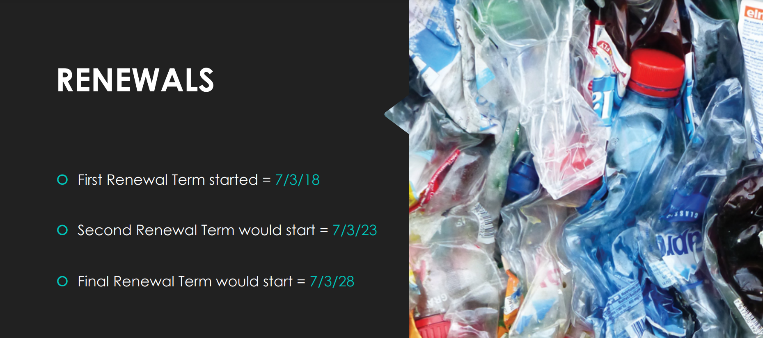

Slide 3
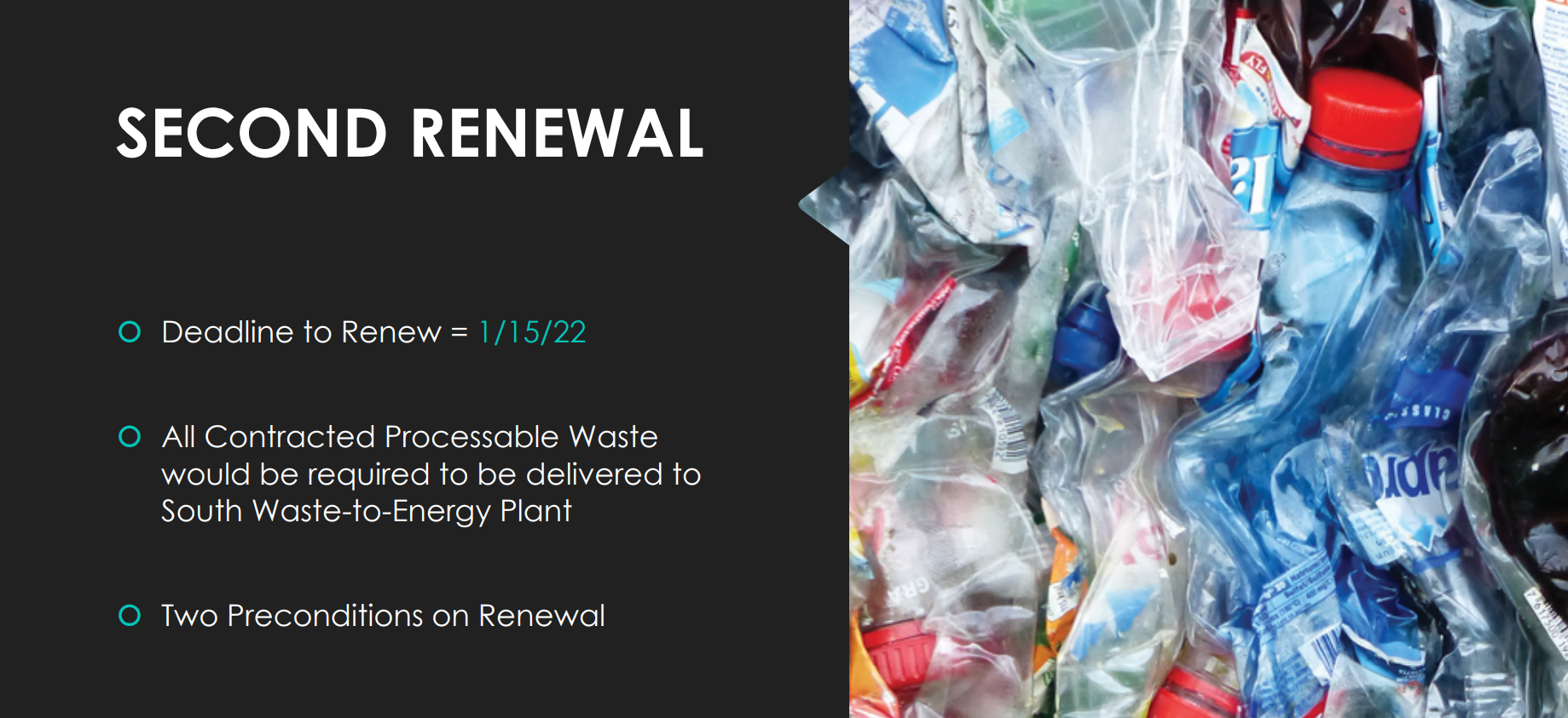

Slide 5
The Need
Working Group MEETING – 03/01/21

Slide 6
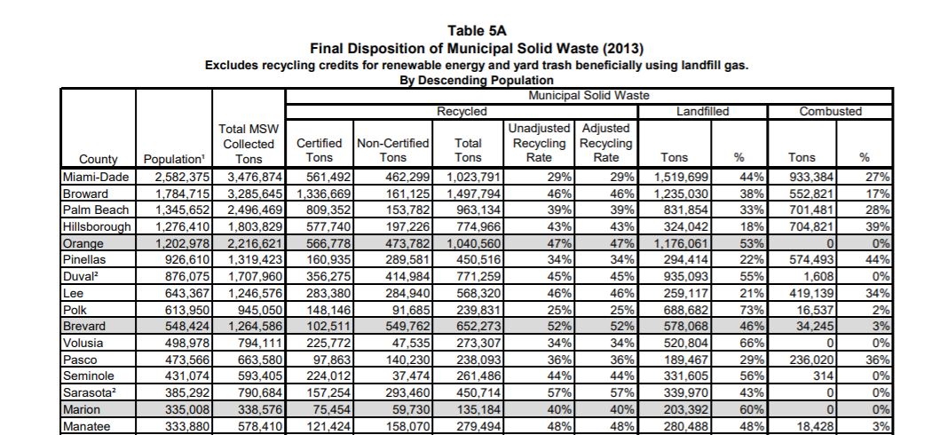

Slide 7
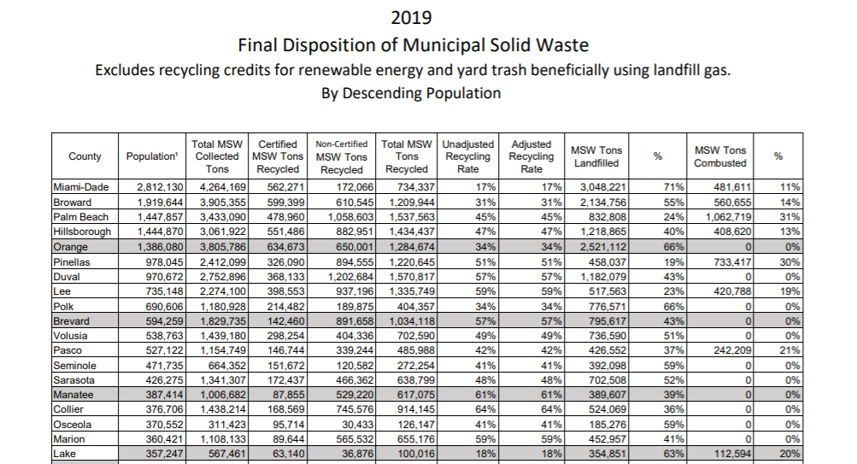

Slide 8
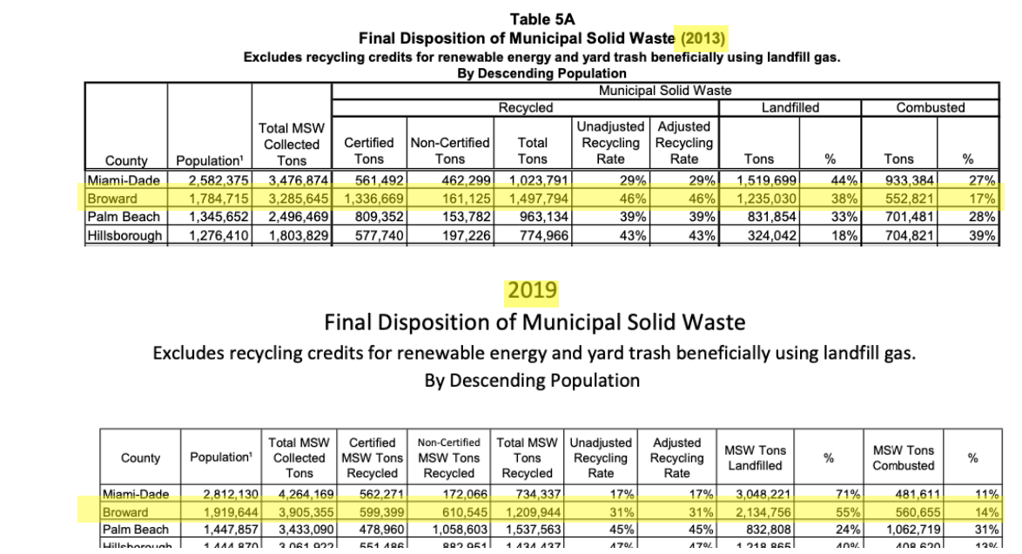

Slide 9
The Cost
Working Group MEETING – 03/01/21

Slide 10
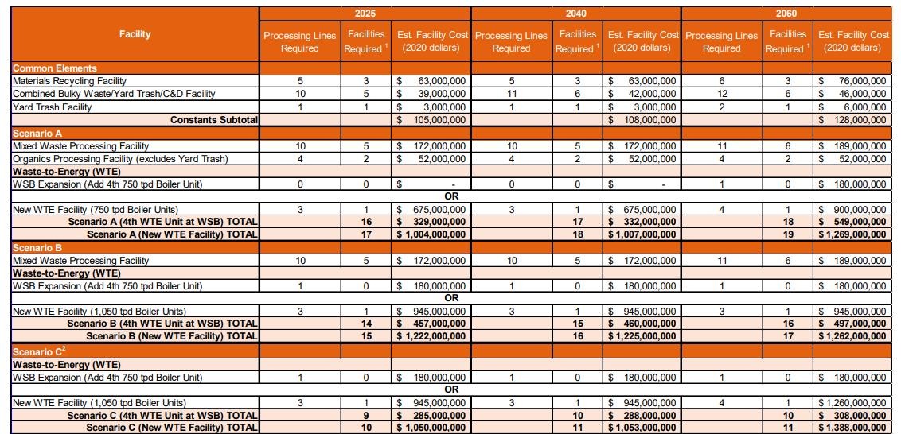

Slide 11
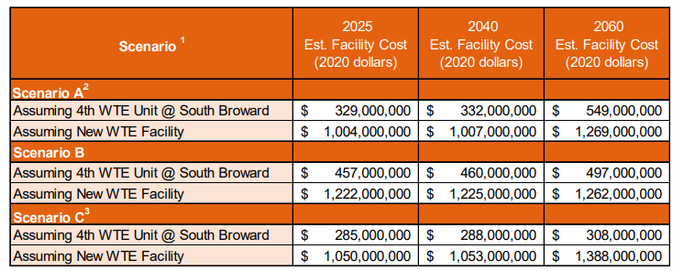

Slide 12
The Assessments
Working Group MEETING – 03/01/21

Slide 13
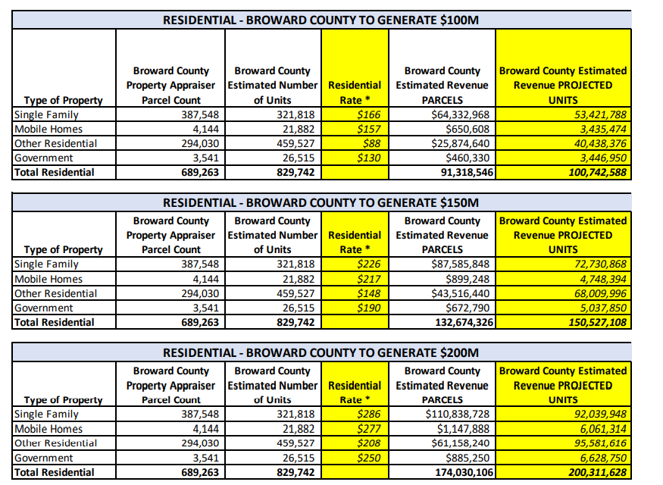

Slide 14
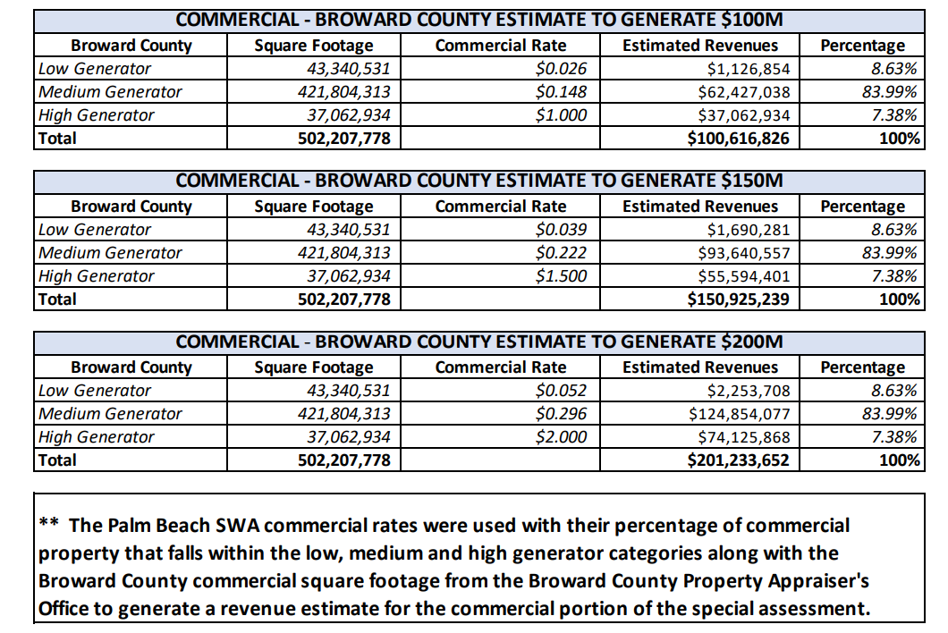

Slide 15
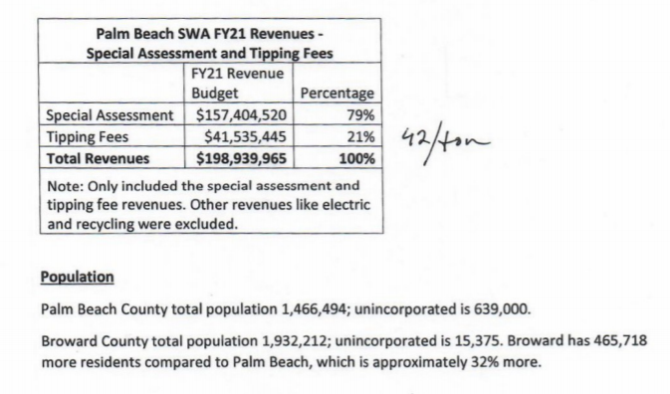

Slide 16
Benefits and Drawbacks of Solid Waste Governing Structures
Working Group MEETING – 03/01/21

Slide 17
Interlocal Agreement
Benefits
Drawbacks
Meets criteria in terms of timeline, money raised, and capabilities.
Local control over all elements after legal entity is formed.
Flexibility in structure and composition.
Can levy appropriate assessments.
No restrictions on facilities, debt, or structure if created properly.
Requires cooperation and communication between all parties – trust is key.
Less historical examples in Florida of raising required amount of money for new capital projects.
Cannot levy taxes, though can levy assessments.

Slide 18
Dependent Solid Waste District
Benefits
Drawbacks
Meets criteria in terms of timeline, money raised, and capabilities.
Local control over all elements.
Flexibility in structure and composition.
Can levy appropriate assessments.
No restrictions on facilities, debt, or structure.
Requires maximum buy-in from all municipalities.
Requires the District to be dependent to the County in one of three criteria – approval of the membership, approval of budget, or serving as governing body.
Potential issue with dual office holding.

Slide 19
Independent Solid Waste District
Benefits
Drawbacks
Meets criteria in terms of money raised, and capabilities.
Independence - not bound to a single entity in anyway.
If legislature allows, flexibility in terms of composition.
Can levy appropriate assessments.
No restrictions on facilities, debt, or structure.
Cedes local control of all elements, from facilities to composition of the District.
Longest timeline – likely not ready until after contracts expire in 2023.
Possible interference from state and other parties – loss of local control concerns.

