Slide 1
Working Together To Create a Comprehensive Solid Waste System for Broward County
Working Group 10/14/19

Slide 2
How Did We Get Here?
2013 - End of Long- Term Disposal Agreements; Entities enter into new contracts
June 2017 –
Arcadis Selected
For Solid Waste Report
May 2015 -
Waste Management Closes North Incinerator
June 2016 –
Alpha 250 Sale
Paused,
Working Group
Formed
December 2017 –
Arcadis Kick Off

Slide 3
Solid Waste and Recycling Issues Study Overview
How can the County attain a 75% recycling goal?
What are the construction costs associated with the needed Facilities?
Will retaining public ownership of Alpha 250 facilitate the County’s meeting the recycling goal or provide other benefits for solid waste disposal?
Investigate solid waste disposal issues and options such as flow control, governance and contractual structures for collaborative solid waste management.

Slide 4
Solid Waste and Recycling Issues Study Project Timeline
Task 1 – Project Kickoff Meeting (December 2017)
Task 2 – Review Existing Documentation
Task 3 – Establish Solid Waste Composition
Task 4 – Estimate Solid Waste Quantity
Task 5 – Identify Alternatives / Options for Improvement to Achieve Recycling Goals
Task 6 – Evaluate Site Requirements
Interim Governance Workshop (February 2018)
Task 7 – Identify Alternatives / Options for the Future of Solid Waste Management in Broward County
Task 8 – Prepare Conceptual Level Cost Estimate
Task 9 – Prepare Technical Memorandum
Task 10 – Prepare Draft Solid Waste and Recycling Issues Study Report (July 2018)
Task 11 – Working Group, Mayor’s Group and Broward League of Cities Workshops (November 2018)
Task 12 – Prepare and Issue Final Report (December 2018)

Slide 5
How to Achieve the 75% Recycling Goal

Slide 6
Solid Waste Composition and Quantity Estimates
The Arcadis Team reviewed a wide array of existing data and information to estimate the solid waste composition of Broward County waste.
Population and per capita waste generation projections were then developed to estimate the quantity of solid waste generated throughout the 20-year and 40-year planning periods.
These solid waste composition and quantity estimates were then used to identify diversion opportunities of greatest interest to the Working Group that could enable Broward County to attain the 75% recycling goal.

Slide 7
Identifying Recycling Opportunities
Estimated Composition of Waste Disposed in Broward County
~ 3,675,000 tons generated annually

Slide 8
Policies Required to Meet 75% Recycling Goal
Enact mandatory C&D debris, bulky waste and yard trash processing prior to disposal
Enact mandatory multi-family and commercial recycling
Require minimum recycling standards for solid waste processing facilities

Slide 9
Facilities and Recycling Scenarios Required to Meet 75% Recycling Goal
Assuming mandatory recycling policies are implemented, the implementation of some combination of six types of solid waste processing facilities are recommended to meet the 75% Recycling Goal:
☞
1. Materials Recycling Facility
4. Mixed Waste Processing Facility
2. Combined Bulky Waste / Yard Trash / C&D Facility
75%
5. Organics Processing Facility (excludes yard trash)
3. Yard Trash Facility (stand alone)
6. Waste-to-Energy Facility (expanding WSB or construct new facility)

Slide 10
Retain North Alpha 250 Site In Public Ownership

Slide 11
North Alpha 250 Site Evaluation
The Alpha 250 Site was evaluated to determine if any of the six facilities required to meet the 75% Recycling Goal could be constructed on the Site.
The following criteria were reviewed:
Current zoning and land use
Available buildable area and site shape
Utilities
Electrical
Water and Wastewater
Traffic impacts
Social and political acceptance
75%

Slide 12
Alternatives and Options for the Future Structure of Solid Waste Management in Broward County

Slide 13
Alternatives and Options for the Future Structure of Solid Waste Management in Broward County
In collaboration with the Working Group, key regulatory requirements, frameworks, and policy issues associated with solid waste management in Broward County were reviewed.
Create legal and economic flow control
Create a collective governance structure to dictate the policies needed to implement the regional solid waste system
Implement a regional solid waste system

Slide 14
Summary and Recommended Next Steps
County and Working Group should retain public ownership of the North Alpha 250 Site.
Cities to extend existing solid waste contracts or negotiate termination for convenience clauses.
Initiate implementation of a collective approach to Governance Structure.
Perform a detailed NPV analysis, siting and feasibility study for the selected scenario, including detailed construction cost estimates.
Select a scenario, or portion of a scenario, that moves toward achieving the 75% Recycling Goal.
Implement proposed policies mandating recycling to assist in achieving the 75% Recycling Goal.

Slide 15
MOU

Slide 16
MOU – Logistics (Jamie Cole)
A. Representation
(i) Each local government has a representative
(ii) Voting
(iii) Sunshine law
B. Establishment of Rules

Slide 17
MOU – Logistics (Jamie Cole)
C. Working Group
(i) Purpose
(ii) Composition (presentation on options to follow)
(iii) Staffing
D. Technical Group
(i) Purpose
(ii) Composition

Slide 18
MOU – Shared Principles/Commitments (Keoki Baron)
(i) The system should be highly collaborative to ensure service to all residents and to take advantage of purchasing economies and other economies of scale.
(ii) Parties to equally consider Arcadis’ recommendations, various preferences of each Party, and results of further study.
(iii) Exploration of all possible governance/organizational structures, with emphasis on local control, flexibility, and flow control.

Slide 19
MOU – Shared Principles/Commitments (Keoki Baron)
(iv) Common ownership and/or control of acquired and constructed public assets; common responsibility for liabilities (e.g., landfill closure and long-term maintenance costs); mutually agreed-upon control of operations.
(v) Common control on setting fees (e.g., tipping), with emphasis on achieving full cost recovery using the lowest practicable fees while still providing a comprehensive range of offerings.

Slide 20
MOU – Shared Principles/Commitments (Keoki Baron)
(vi) Robust recycling programs are necessary even if the current recycling market is not favorable or conducive to recycling.
(vii) Identification and analysis of all available options regarding programs (e.g., contracting with private entities) and assets (e.g., Alpha 250); the Parties’ respective interests in public assets made part of the system to be taken into account in determining the Parties’ financial contributions.

Slide 21
Working Group Composition Discussion (Richard Salamon)
What we are talking about is the MOU Working Group, which is different from the Governing Board of any solid waste authority or district that will be created from the process over the next year.
History: Since the 2013 expiration of the Resource Recovery System (the “RRS”), the former members of the RRS selected six (6) representatives to work with the County on the distribution of assets and to identify a path forward toward collaboratively developing a new regional system:
- Mayor of Fort Lauderdale
- Mayor of Hollywood
- Mayor of Miramar
- Mayor of Sunrise
- Mayor of Weston
- Commissioner from Coconut Creek

Slide 22
Sample Options for Working Group Composition By Top Ten Population (Richard Salamon)
Based on the requirements outlined in the MOU, the composition of proposed working group (five to nine total members) could be:
One (1) Broward County Commissioner (required under MOU).
Four (4) or Five (5) representatives from the ten most populous municipalities in Broward County.
Two (2) or Three (3) representatives from the next ten most populous municipalities in Broward County.
One (1) or Two (2) representatives from the ten least populous representatives in Broward County.

Slide 23
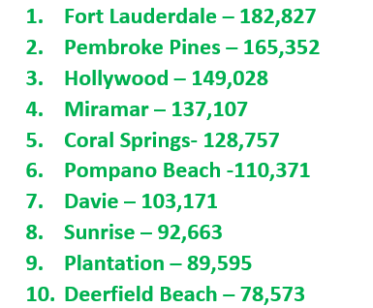
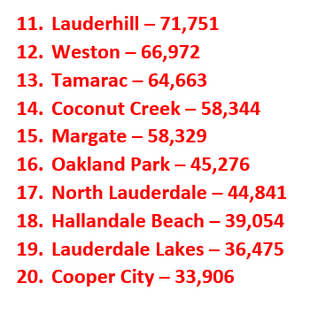
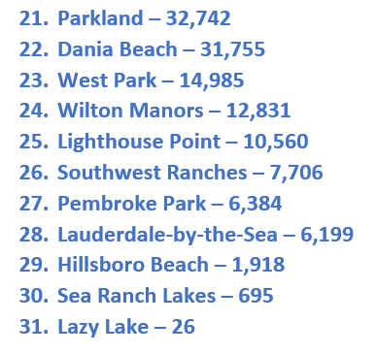
Four or five from Group A
Two or three from Group B
One or two from Group C

Slide 24
Sample Options for Working Group Composition by 1/3 of Population (Richard Salamon)
Based on the requirements outlined in the MOU, the composition of proposed working group (five to nine total members) could be:
One (1) Broward County Commissioner (required under MOU).
Two (2) to three (3) representatives from municipalities representing top third of population in Broward County.
Two (2) to four (4) representatives from municipalities representing middle third of population in Broward County.
Two (2) to three (3) representatives from municipalities representing last third of population in Broward County.

Slide 25
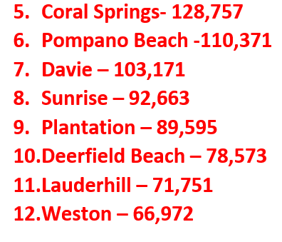
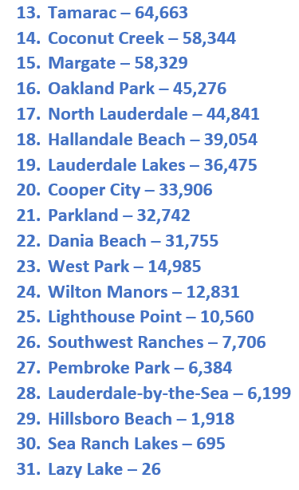
Two or three from Group A
Two to four from Group B
Two or three from Group C

Slide 26
Working Group Composition Discussion (Richard Salamon)
IMPORTANT CONSIDERATIONS:
1. Working Group members will be elected officials from participating MOU communities
2. The MOU members may wish to determine that Working Group members are identified as member agencies (e.g., “Broward County”) rather than individual elected officials who may change over time or be unable to attend all meetings; this would enable “Alternate” representatives to participate on behalf of the Working Group agencies.
3. Working Group members will need to commit significant personal time to this project over the next year
4. Working Group members will need to commit their key staff to significant effort for this project
Regardless of participation on the Working Group, all participating communities will be represented in two important roles:
1. As participating members of the MOU
2. By appointing staff members to the Technical Group (not mandatory)

Slide 27
Overview of Governance Structures

Slide 28
Types of Governance Structures
Dependent Special District
Independent Special District
Singular Government Entity

Slide 29
Governance Overview – Independent Special District (Arcadis)
Governing Rules: Governed by a collective body; not under control of single county or municipality.
Creation: MUST be created and approved by the Florida Legislature.
Characteristics: Collective rule for appointment of members with equal control and voting power; independent control over budget and millage rates; significant state oversight.
Taxing Authority: Millage not subject to millage cap of any other local government.

Slide 30
Governance Overview – Dependent Special District (Arcadis)
Governing Rules: Governed and controlled by single county or municipality.
Creation: Created through ordinance so long as the district lies within the boundaries of creating entity and ALL impacted municipalities approve; can also be created via special act of Florida Legislature.
Characteristics: Governing board sets solid waste policy; selection/retention of board membership subject to controlling entity; controlling entity approves the district’s budget.
Taxing Authority: Can only tax up to a certain limit (millage to be added to millage of creating entity and combined millage subject to millage cap of creating entity).

Slide 31
Types of Governance Structures – DEPENDENT VS. INDEPENDENT SPECIAL DISTRICT
 | SPECIAL DISTRICTS
Criteria for Dependent and Independent Special Districts in accordance with F.S. 189.012 | DEP | IND
Governing body members are identical to governing body members of the county.
All members of the governing body are appointed by a single county or municipality
During their unexpired terms, members of the special district’s governing body are subject to removal at will by the governing body of a single county or a single municipality.
Budget requires approval by governing body vote.
X
X
X
X

Slide 32
Governance Overview – Interlocal Agreement (Arcadis)
Governing Rules: Allows for creation of separate legal entity to make decisions on comprehensive solid waste system.
Creation: Requires municipalities representing at least 50% of County residents to sign on before it can go into effect.
Characteristics: Would provide flexibility for cooperative solutions; created entity would have ability to levy special assessments and establish rates/fees.
Taxing Authority: None.

Slide 33
Special District vs. Singular Government Entity
The main difference is their purpose:
Municipalities and counties:
Provide local general governmental services
Have broad powers
Special districts:
Provide local specialized governmental services
Have very limited, related, and specific prescribed powers

Slide 34
Types of Governance Structures – TYPICAL ADVANTAGES / DISADVANTAGES OF SPECIAL DISTRICTS

Single point of responsibility.
Greater efficiencies achieved through economies of scale.
Less exposure to private sector monopoly.
Fiscal independence.
For Independent Districts, allows parties to participate in governance.
Less control at local level.
Generally requires longer term commitments.
For Dependent Districts, governance structure must conform to the parent organization.

Slide 35
Types of Governance Structures – TYPICAL ADVANTAGES / DISADVANTAGES OF SINGULAR GOVERNMENT ENTITY

Single point of responsibility.
Greater efficiencies achieved through economies of scale.
Less exposure to private sector monopoly.
Overall reduction of administrative burden.
Less control at local level.
Generally requires longer term commitments.
Fiscal dependence.
Regional cooperation required to gain economies of scale.

Slide 36
Next Steps (Michael Cirullo)

