Slide 1


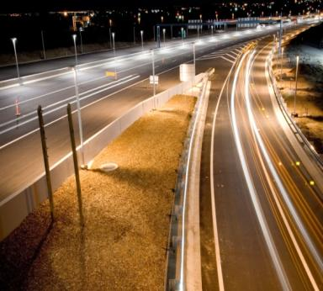
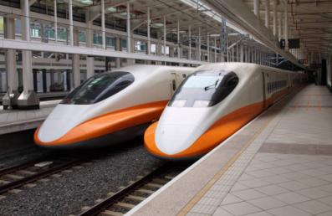
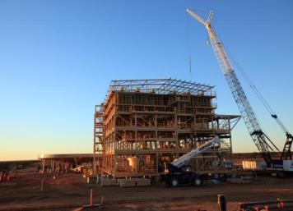
Finding the Revenue Stream to Make P3s Work
Presented by:
David Alvarez
VP Strategic Advisory, CPM
April 28, 2017

Slide 2
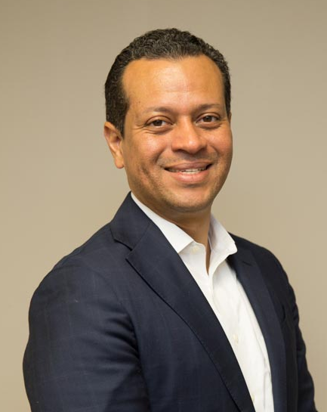

With You Today
David Alvarez
Vice President Strategic Advisory, CPM
14 years of experience.
P3 projects in Pennsylvania, Texas, Florida and Puerto Rico.
Former Director of Puerto Rico P3 Authority.
Technical and P3 advisory and Project Management firm with offices in Florida, Panama and Puerto Rico. Visit us at: www.cpmintl.com
Source: City of Providence

Slide 3
Background on P3s & payment streams
Source: City of Providence

Slide 4
PPPs making significant progress
“[p]ublic-private partnerships in the US… remains positioned to be become one of the world’s largest” [market]…
March 2016
__________
Sources: Moody’s Investor Services, Global Credit Research, March 10, 2016.
Source: City of Providence

Slide 5
What is a PPP?
A P3 IS:
DESIGN AND CONTRUCTION, FINANCING, OPERATIONS AND MAINTENANCE PARTNERSHIP
A RISK SHARING APPROACH
LIFECYCLE PROCUREMENT APPROACH THAT GUARANTEES PERFORMANCE
A TRANSPARENT RELATIONSHIP
A P3 IS NOT:
PRIVATIZATION
A FUNDING SOLUTION
A LOW QUALITY DELIVERY MODEL
THE RIGHT SOLUTION FOR EVERY PROJECT
Source: City of Providence

Slide 6
Increased local interest for PPPs
Florida has made significant progress with successfully delivering State level projects, and university projects, among others.
Since the enactment of FS §287.05712 in 2013 there has been a growing interest by local governments to use PPPs for infrastructure and development projects.
However, local government frequently face challenges associated to the financiability of their P3 projects.
Source: City of Providence

Slide 7
Common challenges for PPPs at local level
A 2014 World Bank report identified at re are at least four major and common challenges
Challenge | Description
Lack of Standardized Documents | Local / small-projects are associated with less analyzed sectors. Little information or standardized practices in those sectors.
Cumbersome Institutional Structures | No separate institutional procedures for processing P3 projects and not clear project discrimination in terms of size or type of project.
Financing Constraints | Financing constraints due to government inadequate fiscal resources, credit-worthiness, lack of clear revenue streams for the projects, etc.
Need for Capacity Building | Training needed in P3 business case, procurement, contract development and communications are critical.
1
2
3
4
__________
Sources: World Bank Group, August 2014, “A Preliminary Review of Trends in Small Scale Public-Private Partnerships Projects.”

Slide 8
P3s are not “free”
The cost of an infrastructure project and private capital must eventually be paid.
Two Main Forms of Payment
$
User Fees
Taxpayers
Revenue-based payment is when the demand risk resides with the concessionaire.
Availability payment: the government makes monthly payments for making the infrastructure available for use.

Slide 9
IMPORTANCE OF REVENUE STREAM in P3s
Source: City of Providence

Slide 10
Main financial streams in a PPP
Funding
Financing
Public money made available to the project.
This contributed capital is not intended to be repaid or carry a cost or return.
Typical sources include:
  Availability Payments
  User Fee Revenue
    Tolls
    Fees/charges
    Rent
Money provided by private investors to pay for construction costs, concession payments and other large project costs.
This capital has to be repaid and carries a cost:
  Debt
  Equity

Slide 11
Role of revenue streams
Project
Revenues
Streams
Project
Financing
SPV
(P3 Company)
Company Equity
Subordinated Debt
Bank Loans
Government Grants
Construction
Bond ratings
Company Equity
3rd Party Equity
Bondholders
Insurance companies
Toll or user revenues
Revenue guarantees
Availability Payments
Subsidies
Rents
Any other user fees
Operation
__________
Sources: Engel, Fischer and Galetovic. Finance and Public-Private Partnerships. Conference Volume. Reserve Bank of Australia.
Source: City of Providence

Slide 12
Finding a revenue stream
Source: City of Providence

Slide 13
Revenue streams can be found
Revenue or payment streams tend to be difficult to find when public sponsor has fiscal constraints and/or project subject to P3 is non-transportation related
Main non-tax/fee strategies for finding a revenue stream:
  Consider leveraging other assets that can be incorporated into the project.
  Incorporate real estate elements into the project.
  Push-out charges related to lease payments or other required payments. Back-ended features and structures.
  Identify a related budgetary revenue stream to support the project.

Slide 14
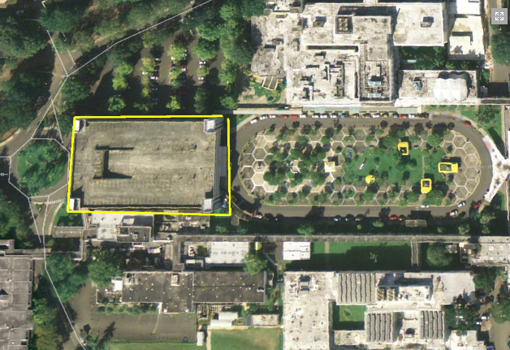
Example – Social Infrastructure Project
Owner: Government
Facility: Large medical facility
Project: Substantially improve and modernize the medical facility. Invest estimate of $150 – $175 million in capital improvements.
Challenge: Budget constraints and no clear payment source.
Solution: Potential solution is incorporating a large existing parking garage.
Aerial picture of Government Owned Medical Facility

Slide 15
Conclusion
Source: City of Providence

Slide 16
Conclusion
Interest of local Governments to deliver PPP projects keeps increasing.
PPP projects at local levels tend to have a specific set of challenges.
Clearly identifying payment source or revenue streams is critical to make the P3 project viable and/or financeable.
There are strategies to find a payment or revenue stream to make P3s work but they vary depending on the conditions of each jurisdiction and project characteristics.
Source: City of Providence

