Slide 1

Public Finance 101
David E. Keller, Assistant City Manager/Chief Financial Officer, City of Weston
Nancy Morando, Finance Director, City of Parkland
Broward League of Cities Workshop
April 16, 2015

Slide 2
Overview
1) GASB/GAAP
Basic Terminology
Basic Financial Statements
Understanding Financial Statements:
  MD&A
  Notes to Financial Statements
5) Financial Stability
6) Financial Indicators

Slide 3
GASB – Government Accounting Standards Board
The Government Accounting Standards Board is an independent, not-for-profit organization formed in 1984 that establishes and improves financial accounting and reporting standards for state and local governments. Its seven members are drawn from the Board’s diverse constituency.
GASB is recognized as the official source of generally accepted accounting principles for state and local governments, and established modified accrual accounting standards which distinguish government accounting from business accounting.

Slide 4
GAAP – Generally Accepted Accounting Principles
The common set of accounting principles, standards and procedures that entities use to compile their financial statements. GAAP are a combination of authoritative standards (set by policy boards, such as GASB) and simply the commonly accepted ways of recording and reporting accounting information.

Slide 5
What is a fund?
Fund accounting is an accounting system emphasizing accountability rather than profitability, used by nonprofit organizations and governments. In this system, a fund is a self-balancing set of accounts, segregated for specific purposes in accordance with laws and regulations or special restrictions and limitations.
Government agencies have special requirements that must be shown in financial statements and reports, “how money is spent”, rather than how much profit was earned.

Slide 6
Types of Funds
PROPRIETARY FUNDS
(Economic Resources/Full Accrual)
Enterprise Funds
Internal Service Funds
FIDUCIARY FUNDS
(Economic Resources/Full Accrual)
Agency Funds
Pension Funds
Investment Trust Funds
Private Purpose Trust Funds
GOVERNMENTAL FUNDS
(Current Resources/Modified)
General Fund
Special Revenue Fund
Capital Project Fund
Debt Service Fund
Permanent Fund
Special Assessment

Slide 7
Full Accrual
Is the process of tracking only transactions not cash flow. In accrual accounting, the point is to actually record all transactions when they take place.
When a business performs a service it records the income earned, when it buys an item it records the expense.
Modified Accrual
Combines some elements of cash method of accounting with the full accrual method. Income earned is primarily the same as full accrual, but expenses are only recorder when they are paid.
When a City decides to buy an asset and actually purchases it, the expense will only be counted – and only reduce net income-- in the period which the check is actually cashed.

Slide 8
What is a CAFR?
Comprehensive Annual Financial Report
A set of governmental financial statements that complies with the accounting requirements promulgated by the Governmental Accounting Standards Board (GASB).
A CAFR is "compiled" by accounting staff and "audited" by an external American Institute of Certified Public Accountants (AICPA) certified accounting firm utilizing GASB requirements. It is composed of three sections: Introductory, Financial and Statistical. It combines the financial information of fund accounting and Enterprise Authorities accounting.

Slide 9
Basic Financial Statements

Slide 10
Three Basic Financial Statements
1) Balance Sheet
2) Income Statement
3) Statement of Cash Flows

Slide 11
Balance Sheet
The balance sheet is one of the key components of the financial statements.
The balance sheet presents “assets”, which are the resources it controls that enable it to provide services.
It also presents “liabilities”, which are amounts owed (virtually unavoidable obligations to sacrifice resources). They are generally expected to be satisfied within a year.

Slide 12
Balance Sheet
Fund balance is the third part of the balance sheet. It is the difference between assets and liabilities – in essence, what would be left over if the assets were used to satisfy the liabilities.
The “balance” in the balance sheet is between assets on one hand and liabilities plus fund balance on the other.

Slide 13
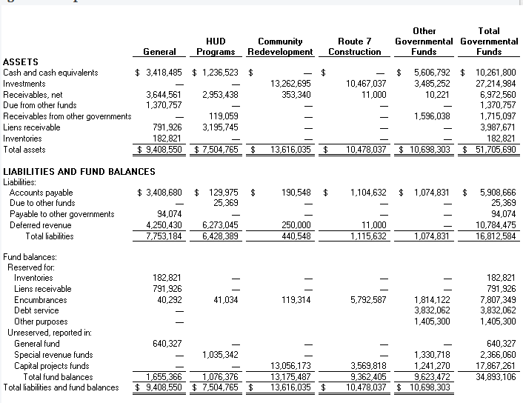
Sample Balance Sheet

Slide 14
Income Statement
For non-governmental corporations and businesses, you have probably heard the basic terms balance sheet, income statement, and statement of cash flows.
For governments’ governmental funds, the income statement is called the Statement of Revenues, Expenditures, and Changes in Fund Balances.

Slide 15
Statement of Revenues, Expenditures, and Changes in Fund Balance
This statement tracks the flow of resources in and out.
  Revenues are shown by source or type.
  Expenditures are generally shown by function and object. (for example, by departmental function, sorted by operating, debt service, and capital expenditures).
  Other financing sources and uses shows cash received when bonds are issued, as well as transfers between funds.

Slide 16
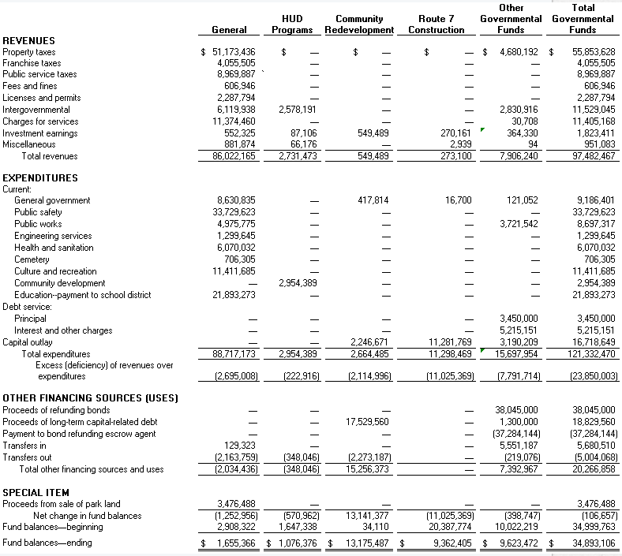
Sample Statement of Revenue, Expenditures, and Changes in Fund Balances

Slide 17
Statement of Cash Flows
Not used in governmental funds. It is used, however, in proprietary funds.
The primary purpose of a statement of cash flows is to provide relevant information about the cash receipts and cash payments of an entity during a period.

Slide 18
Statement of Cash Flows
When used with related disclosures and information in other financial statements, this should help users assess:
  An entity’s ability to generate future net cash flows;
  Its ability to meet its obligations as the come due;
  Its need for external financing;
  The effect on the entity’s financial position of its cash and noncash investing, capital and financing transactions

Slide 19
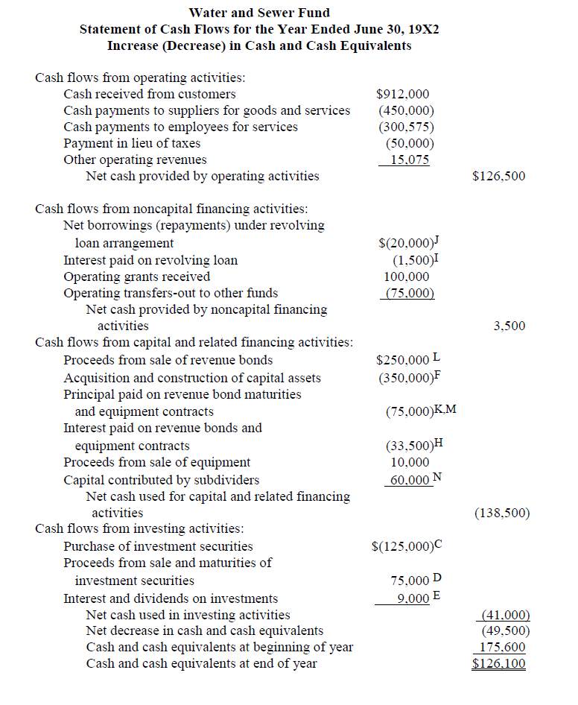
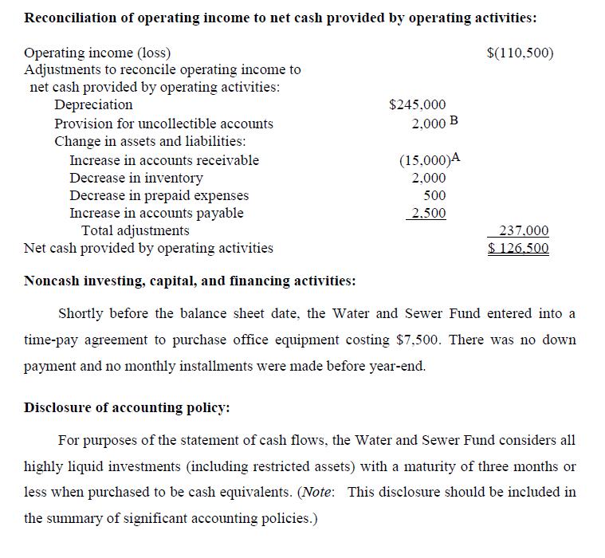
Example Statement of Cash Flows

Slide 20
Understanding Financial Statements

Slide 21
Management Discussion and Analysis (MD&A)
Provides an overview of the City’s financial condition
Identifies changes in the City Financial position
Identifies any material deviations from the financial plan (the approved budget)
Identifies any individual fund issues or concerns

Slide 22
Management Discussion and Analysis (MD&A)
Financial Highlights
Overview of Financial Statements
Government-Wide Financial Analysis
Financial Analysis of the Government’s Funds
General Fund Budgetary Highlights
Capital Projects Fund
Capital Assets and Debt Administration
Local Economy and Economic Factors

Slide 23
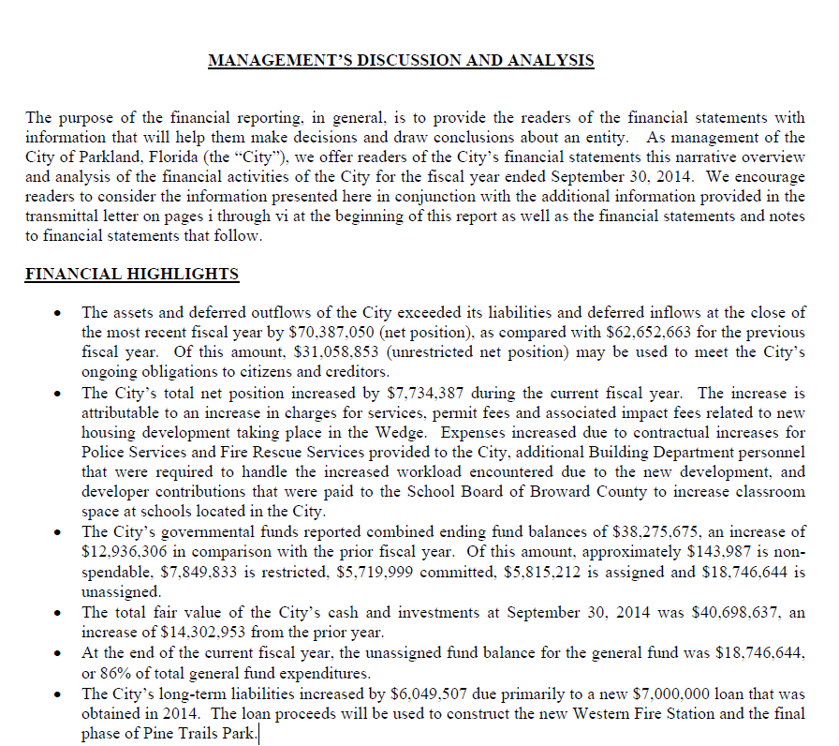

Slide 24
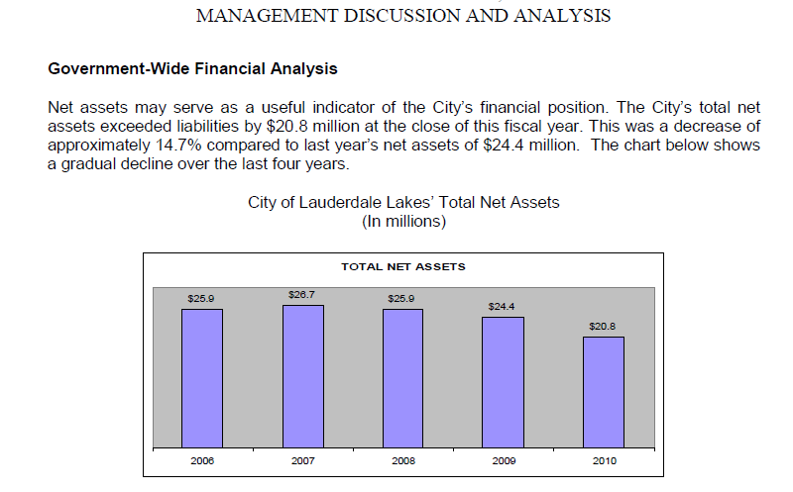
Net Position
Bad

Slide 25
Notes to the Financial Statements
The Notes are an integral and essential part of the basic financial statements. They provide three types of information:
  Descriptions of policies underlying the amounts displayed in the financials statements;
  Additional detail or explanations concerning amounts displayed in the financial statements; and
  Additional information on items that do not meet the criteria for recognition and so are not reflected in the financial statements.

Slide 26
Notes to the Financial Statements
Examples of information included in the Notes:
  Organization and operations
  Summary of significant accounting policies
    Reporting entity
    Government-wide and fund financial statements
    Measurement focus
    Assets, liabilities and fund balance
    Includes compensated absences

Slide 27
Notes to the Financial Statements
Examples of information included in the Notes:
  Deposits and investments, includes explanation of risk
  Restricted assets
  Interfund receivables, payables and transfers
  Capital assets, capital leases
  Special assessment bonds
  Long-term debt
  Risk management, insurance

Slide 28
Notes to the Financial Statements
Examples of information included in the Notes:
  Commitment and contingencies
  Claims payable
  Other post employment benefits (OPEB)
  Retirement plans
  Subsequent events

Slide 29
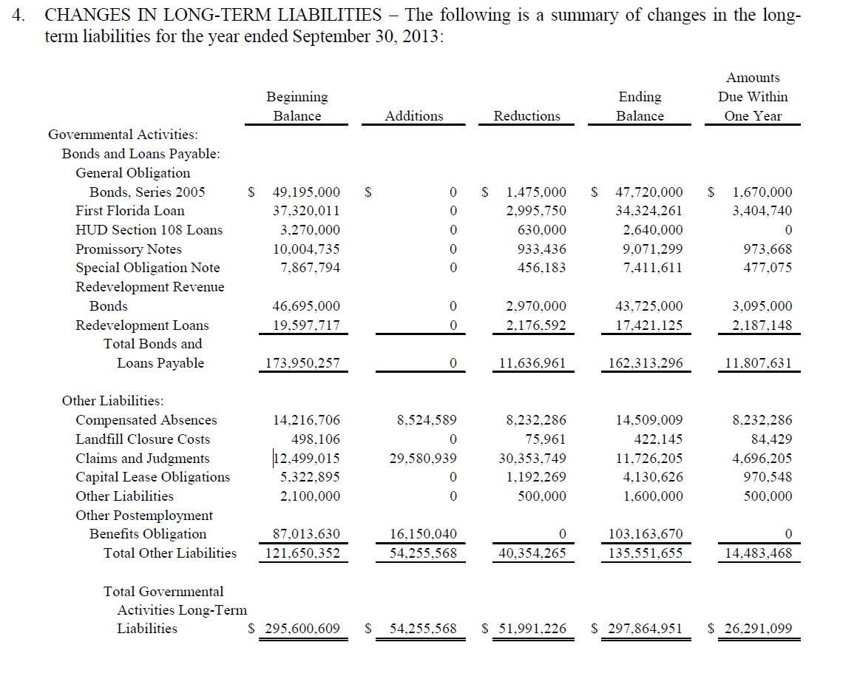
Example of data presented in Notes

Slide 30
Financial Stability

Slide 31
Stabilization/Operating Reserve

Slide 32
Fund Balance
What is fund balance?
The difference between the assets and liabilities reported in a governmental fund
As an approximate measure of liquidity , fund balance is similar to the working capital of a private-sector business

Slide 33
GASB Statement No. 54
This Statement was implemented to change the way governments categorize and present their fund balances.
GASB 54 was implemented for financial statements for periods beginning after June 15, 2010.

Slide 34
Components of Fund Balance
(GASB Statement No.54)
Non Spendable Fund Balance - not in spendable form and/or contractually required, such as inventories, prepaid expenditures, donation from a citizen
Restricted Fund Balance - Limitations imposed by creditors, grantors, contributors and other governments through law, such as gasoline taxes restricted to use for road repair
Committed Fund Balance - resources that are constrained by limitation that the government imposes upon it’s self at the highest level of decision making
Assigned Fund Balance - intended use of resources
Unassigned Fund Balance - excess fund balance

Slide 35
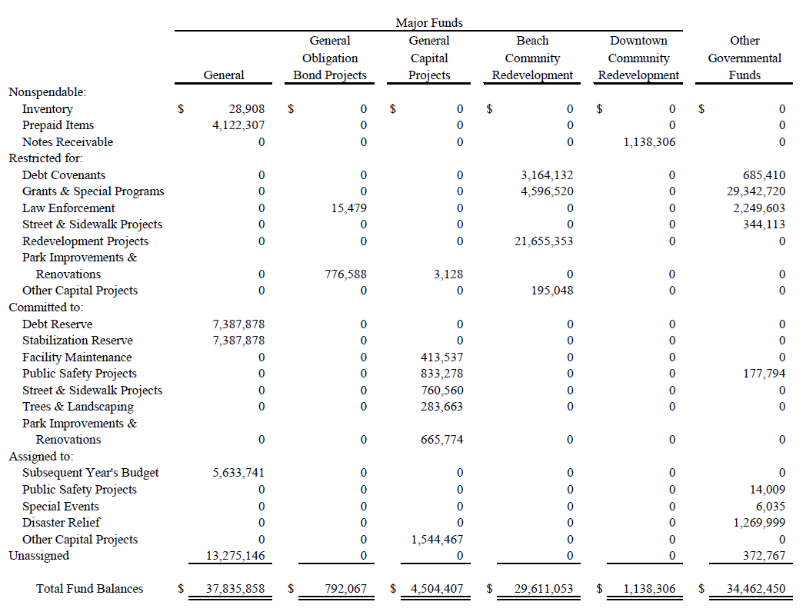
Sample GASB Statement No. 54 Fund Balances

Slide 36
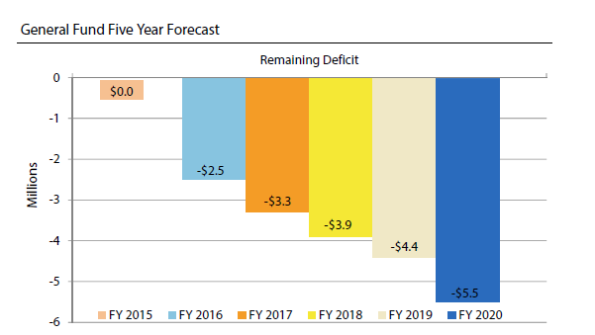
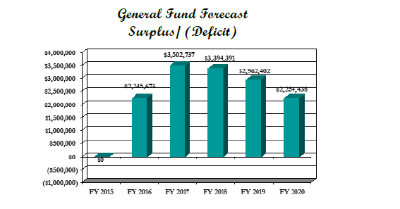
Financial Forecasting
Deficits
Bad
Surpluses
Good

Slide 37
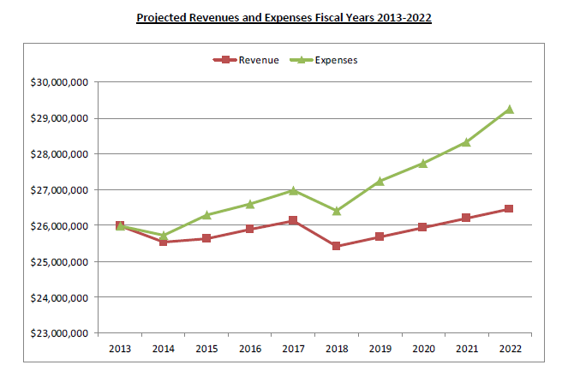
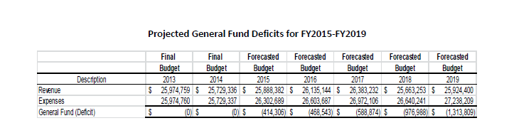
Deficits
Bad

Slide 38
Financial Stability: Interfund Payables, Receivables, and Transfers
Does the City have a policy on interfund transfers?
  What funds are involved in interfund transfers? Are proprietary funds supporting the General Fund?
  Under what circumstances are interfund transfers acceptable?
  Are excessive interfund transfers masking a structural imbalance in the General Fund?

Slide 39
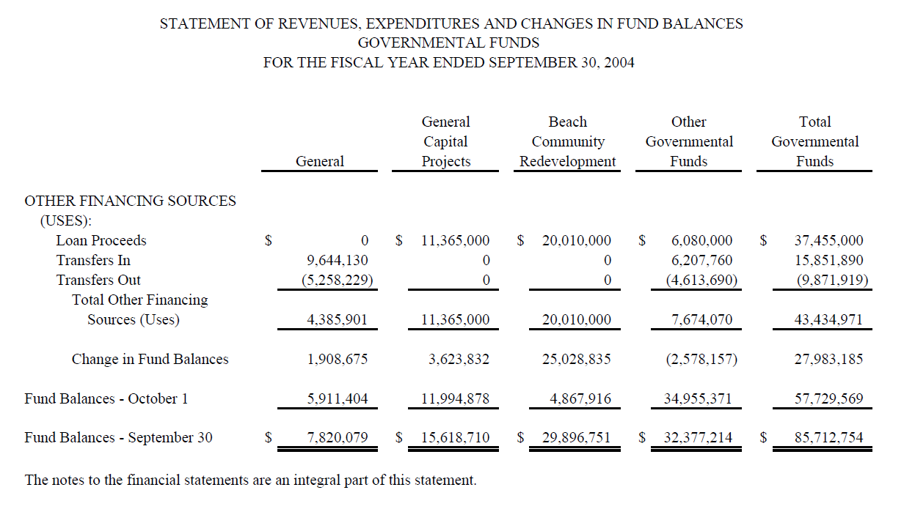
Interfund transfers show in Statement of Revenues, Expenditures and Changes in Fund Balance

Slide 40
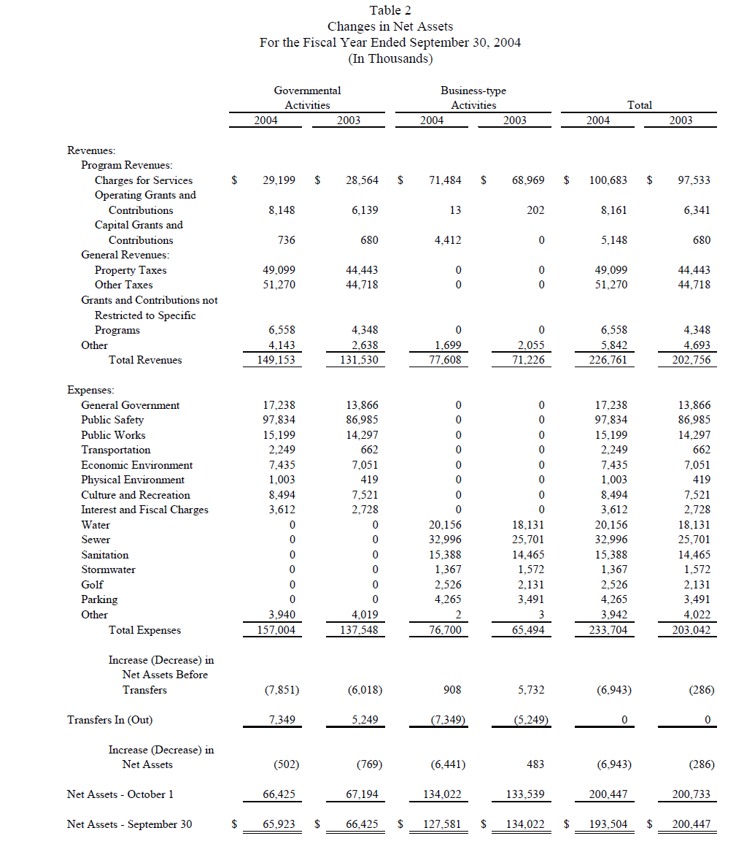
Interfund Transfers may be summarized in MD&A

Slide 41
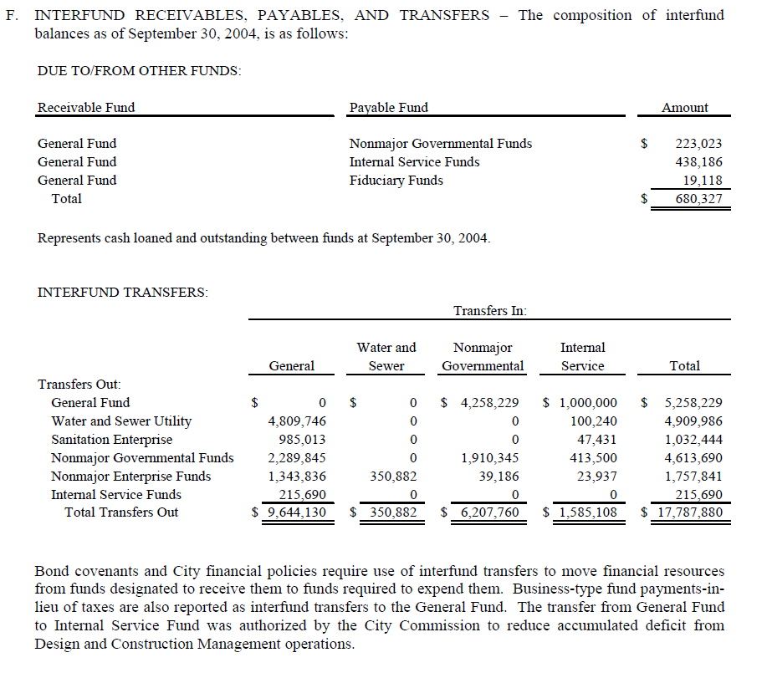
Interfund Transfers will show in the Notes

Slide 42
Debt Management Policy
GFOA recommends in its Best Practice on debt management policies that they should be adopted by the City Commission.
Some states set limits by constitution or law, Florida does not.
Borrowing funds without clear policies can lead to confusion and misuse of borrowed funds.

Slide 43
Debt Management Policy
GFOA suggests debt management policies can include:
  Purposes for which debt proceeds may be used or prohibited;
  Types of debt that may be issued or prohibited;
  Relationship to and integration with the capital improvement program; and
  Policy goals related to economic development, including use of TIF and public-private partnerships.

Slide 44
Debt Management Policy
Ratios can and probably should be set to put limits in place for borrowing funds, such as:
  Debt per capita;
  Debt to personal income;
  Debt to taxable property value; and
  Debt service payments as a percentage of general fund revenues or expenditures.
Appropriate debt limits can have a positive impact on bond ratings.

Slide 45
Financial Indicators

Slide 46
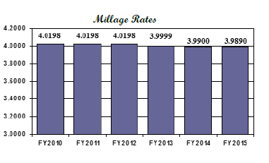

Millage Rate & Per Capita Taxable Values
Millage Rate
Per Capita Taxable Values
2014 3,399,588,704 / 26,273 = 129,395
2013 3,156,184,170 / 25,576 = 123,404
2012 2,980,682,340 / 24,391 = 122,204
High Number/Going Up Indicates Ability to Raise Revenue & Measures Wealth
Constant/Going Down/Low Indicates Strong Financially

Slide 47
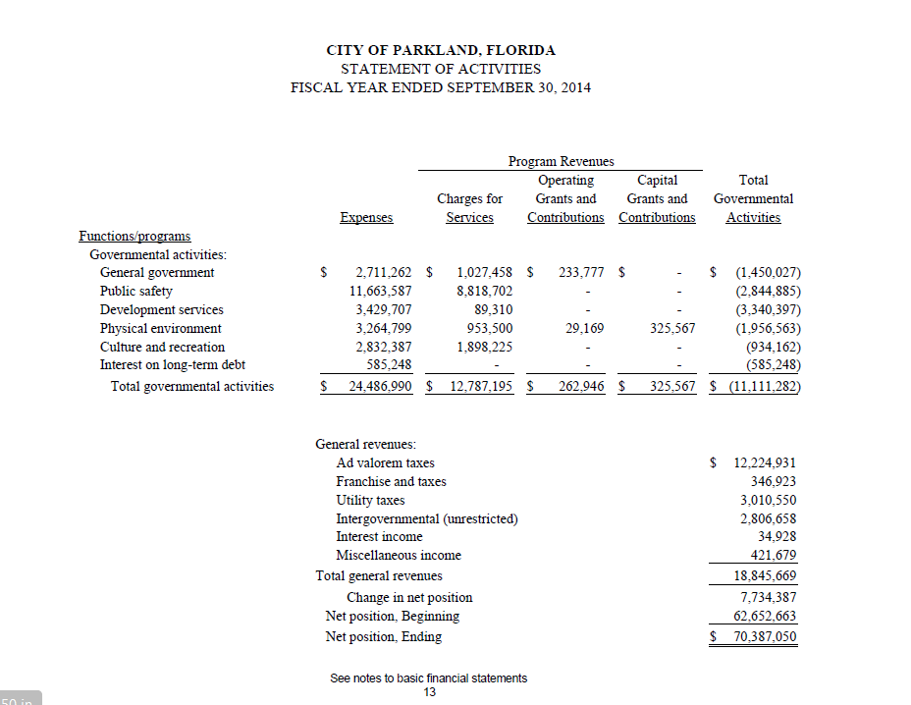
Change in Net Position / Beginning Net Position
Resource Flow Positive
Year End 2014 7,734,387 / 62,652,663 = 12.3%
Year End 2013 6,097,550 / 56,555,113 = 10.8%
Year End 2012 2,899,360 / 53,655,753 = 5.4%

Slide 48
Financial Indicators
Debt Service/Total Expenditures
Percentages increasing over time may indicate declining flexibility the local government has to respond to economic changes.
  Debt service figures comes from the Statement of Revenues, Expenditures and Changes in Fund Balance
  Total expenditures amount comes from Statement of Revenues, Expenditures and Changes in Fund Balance

Slide 49
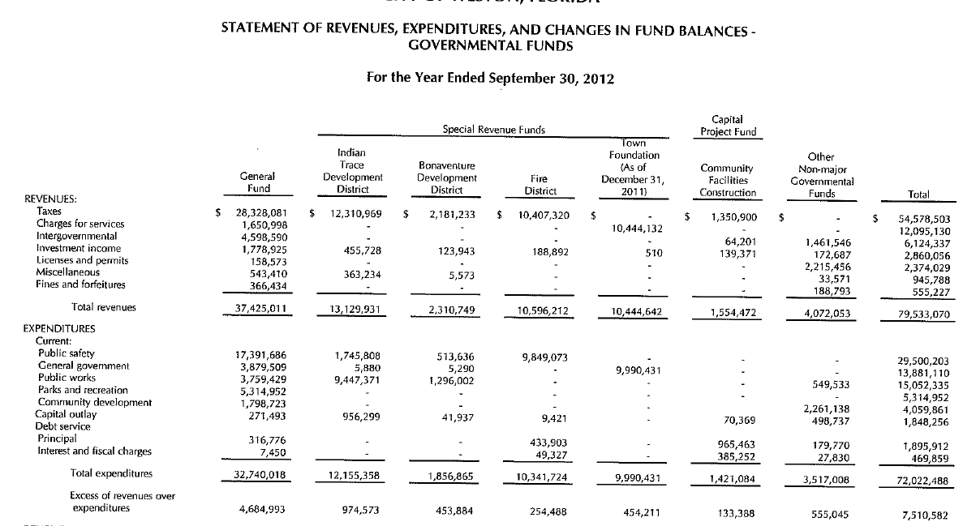
Debt Service/Total Expenditures

Slide 50
Debt Service/Total Expenditures
From the previous table:
Debt service: $316,776+$7,450=$324,226
Total expenditures: $32,740,018
Debt Service/Total Expenditures:
$324,226/$32,740,018=0.99%

Slide 51
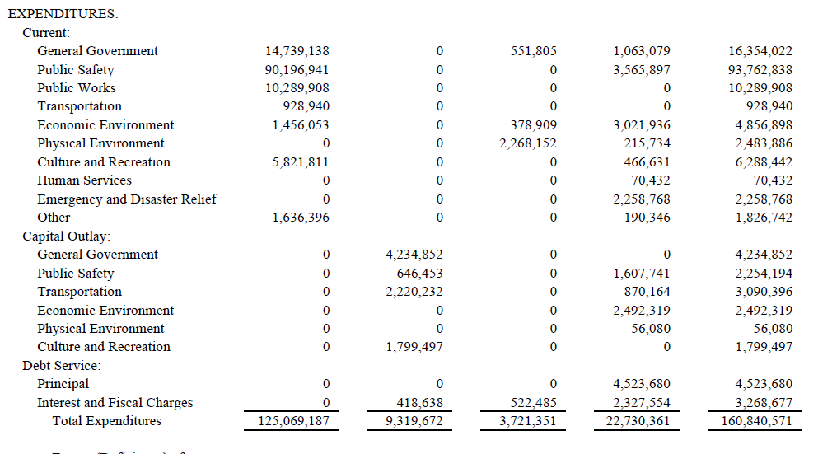
Example 2

Slide 52
Debt Service/Total Expenditures
From the previous table:
Debt service:
$4,523,680+$3,268,677=$7,792,357
Total expenditures: $160,840,571
Debt Service/Total Expenditures:
$7,792,357 / $160,840,571 = 4.84%

Slide 53
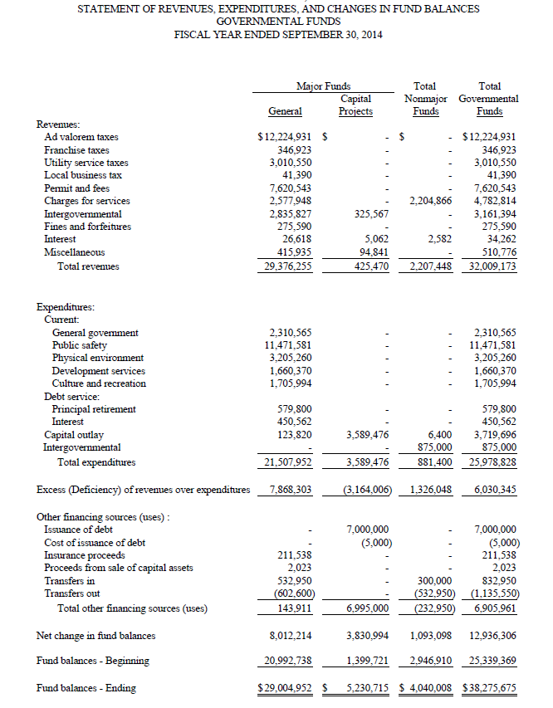
Unassigned & Assigned Fund Balance / Total Expenditures
Y/E 2014 38,275,675 / 25,978,828 = 147%
Y/E 2013 25,339,369 / 22,372,029 = 113%
Y/E 2012 19,834,875 / 22,839,394 = 86%
% Going Up Indicates Structured Budget

Slide 54
Pension Plan Funded Ratio
Ideally the funding should be increasing over time. Decreasing trend may indicate an increasing burden on the tax base and/or poor plan management.
  Plan funding ratio is set forth in the Notes to the Financial Statements

Slide 55
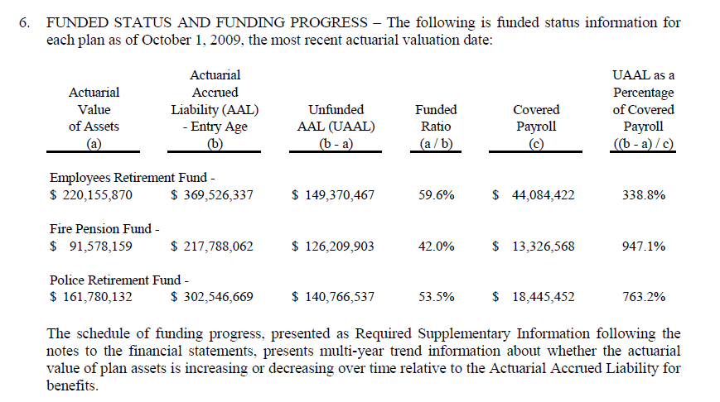
Pension Plan Funded Ratio

Slide 56
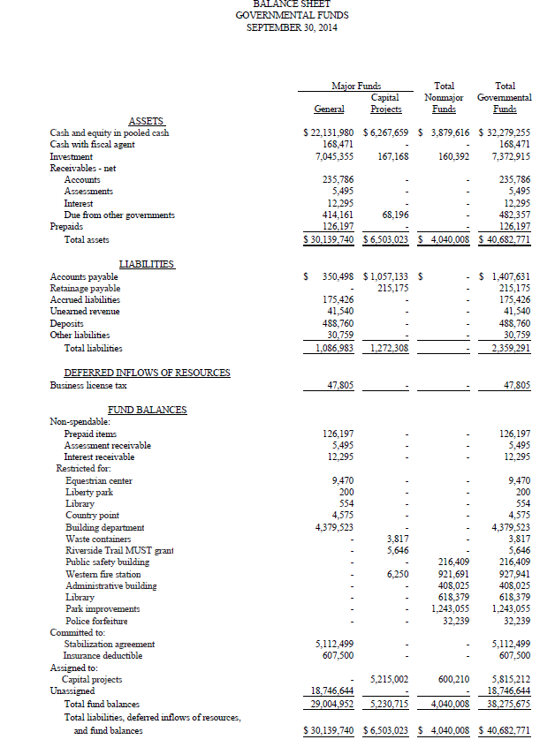
Cash & Investment / Total Expenditures
Year End 2014 39,820,641 / 25,978,828 = 153%
Year End 2013 25,757,366 / 22,372,029 = 115%
Year End 2012 20,369,676 / 22,839,394 = 89%
% Going Up Indicates Government Has Not Over Extended Itself/Cash Is Available

Slide 57
Financial Indicators
OPEB Funded Ratio
Ideally the funding should be increasing over time. Decreasing trend may indicate an increasing burden on the tax base and/or poor plan management. Entities that use the pay-as-you-go method will see increasingly greater cost in the future compared with those that fund the plan
  OPEB funding ratio is set forth in the Notes to the Financial Statements

Slide 58

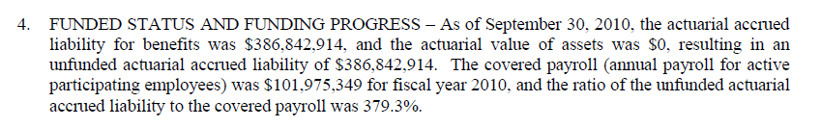
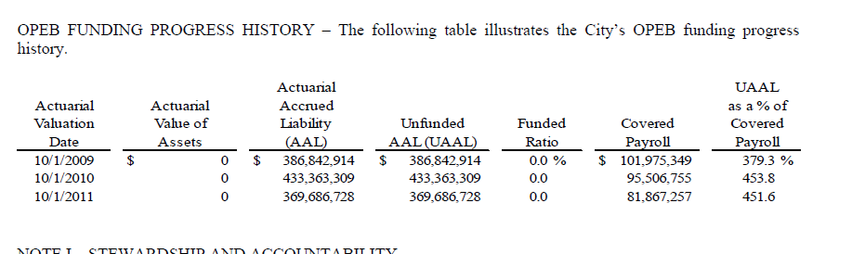
OPEB Funded Ratio

Slide 59
Excess Revenues Over (Under) Expenditures/ Total Revenues
Year End 2014 6,030,345 / 32,009,173 = 19%
Year End 2013 1,210,730 / 24,050,124 = 5%
Year End 2012 5,794,568 / 28,166,597 = 20%
Current Revenues are Supporting Current Expenditures

Slide 60
Financial Indicators
Unassigned Fund Balance Year/Year
Unassigned fund balance is the fund balance that provides flexibility to the city. Too low indicates possible concerns for no resources for the unexpected and millage rate increases; too high may indicate a higher than necessary millage rate.
  Data is shown in the Balance Sheet.

Slide 61
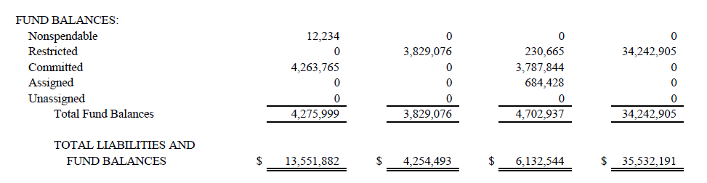
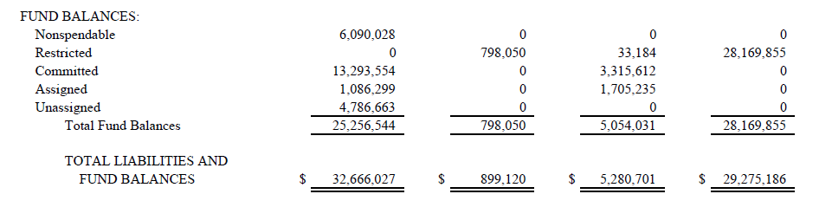
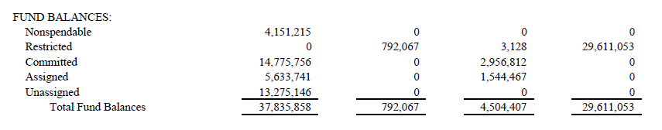
Unassigned Fund Balance
FY 2011
FY 2012
FY 2013

Slide 62
Questions?

Slide 63

The End
Thank you for your attention!

