Slide 1
Zoning and Business Regulations
Medical Marijuana: An Engaging Dialogue Broward League of Cities
October 17, 2014
Susan L. Trevarthen, Esq., FAICP
Weiss Serota Helfman Cole Bierman & Popok, PL

Slide 2
Other Experiences
23 States plus Washington D.C. allow medical marijuana and Washington State and Colorado allow recreational marijuana as well
Across the board, the experiences have all shown one thing, preparation is key.
Those who regulate (or prohibit) early and strictly, suffer the least.
Source: Procon.org, 7/31/14
Source: Altered States: Where Will Marijuana Be Legal Next?, Vocaiv.com, 1/24/14

Slide 3
Overview: What Kinds of Regulations Might Cities Consider?
Definitional Issues
Prohibition or Moratorium
Zoning Regulations – Use and Development Standards
Business Regulations
Evaluate in Light of the Nature of Your Community to See What is Compatible
Lobby for the State Laws to Retain Respect for Local Zoning and Land Use Regulations, if a Local Government Adopts Them

Slide 4
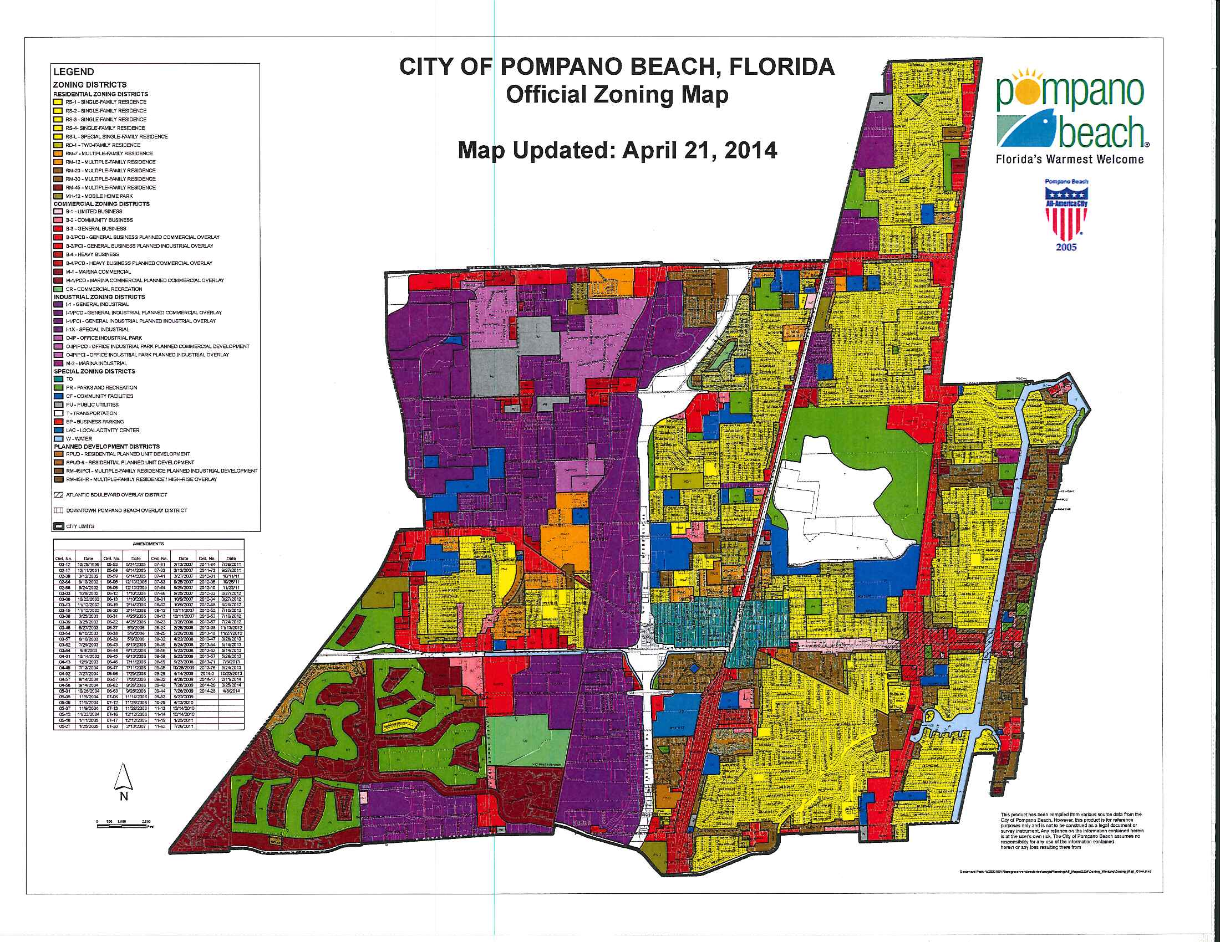
A Tale of Many Cities

Slide 5
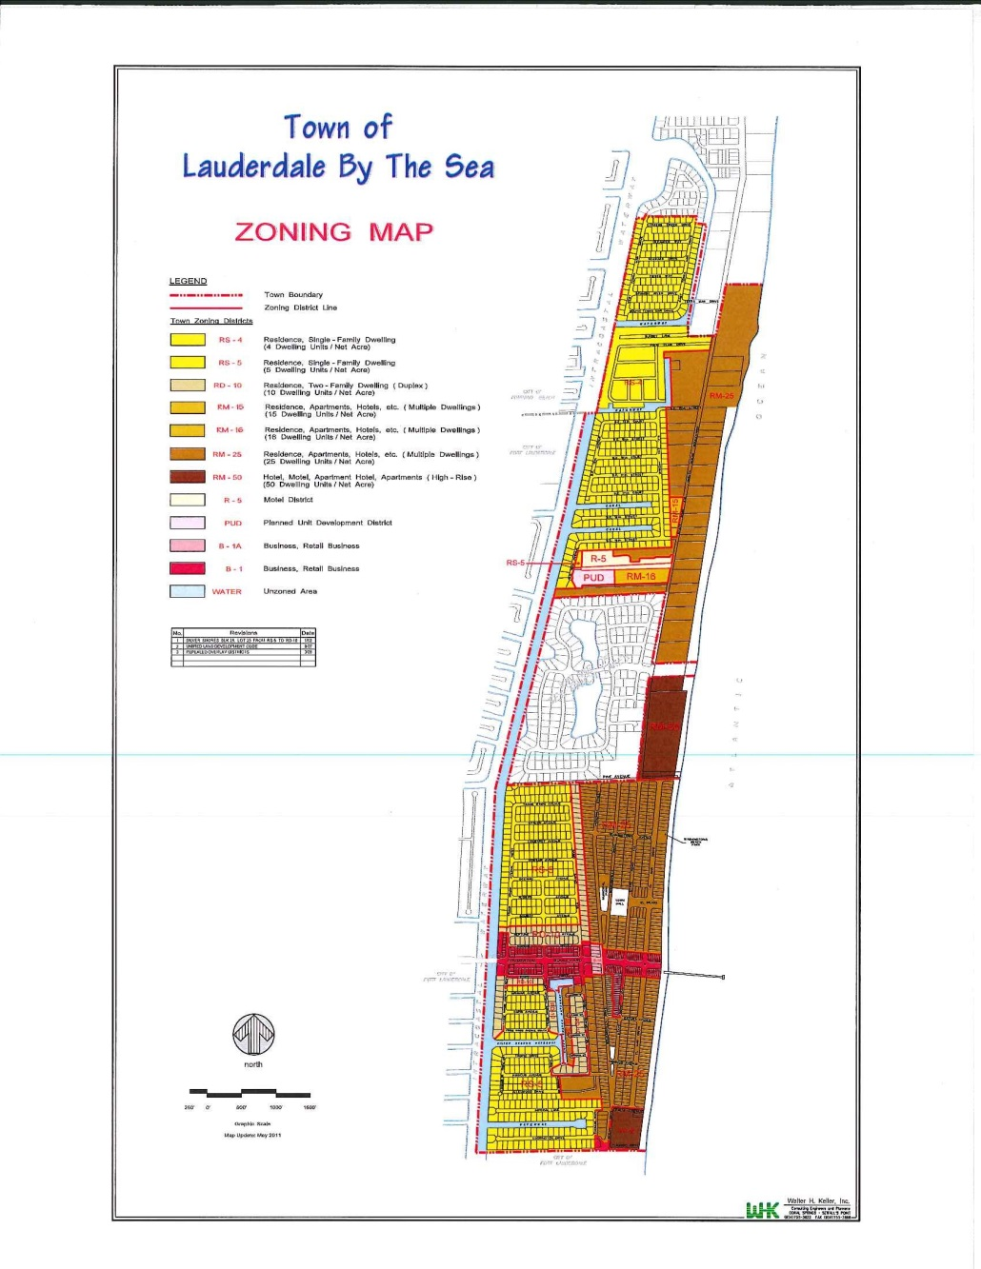
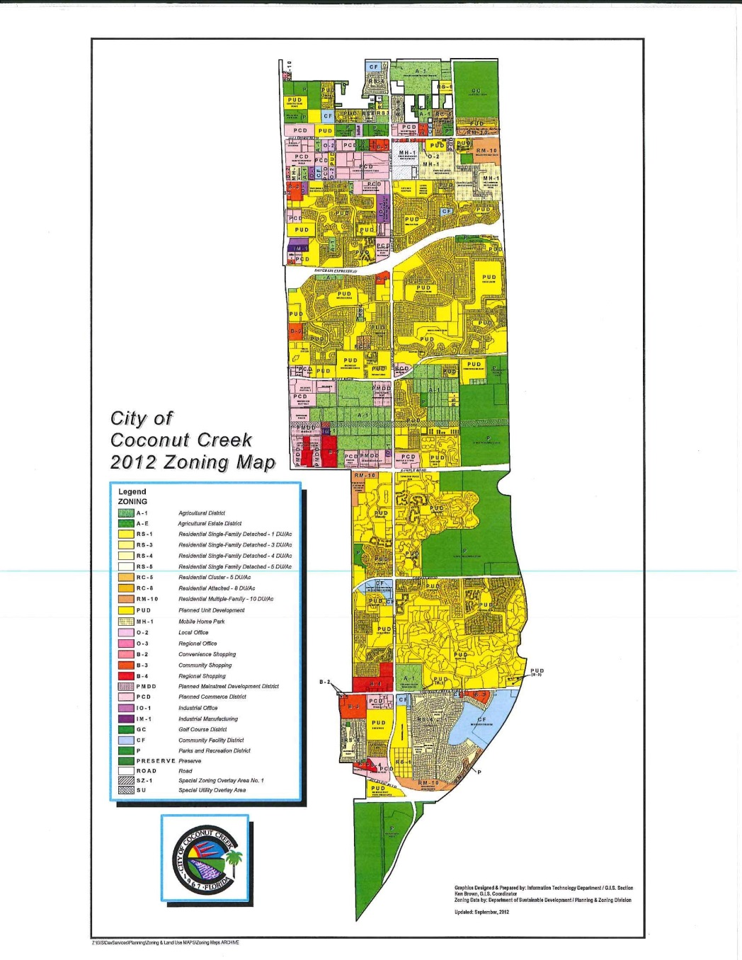
A Tale of Many Cities

Slide 6
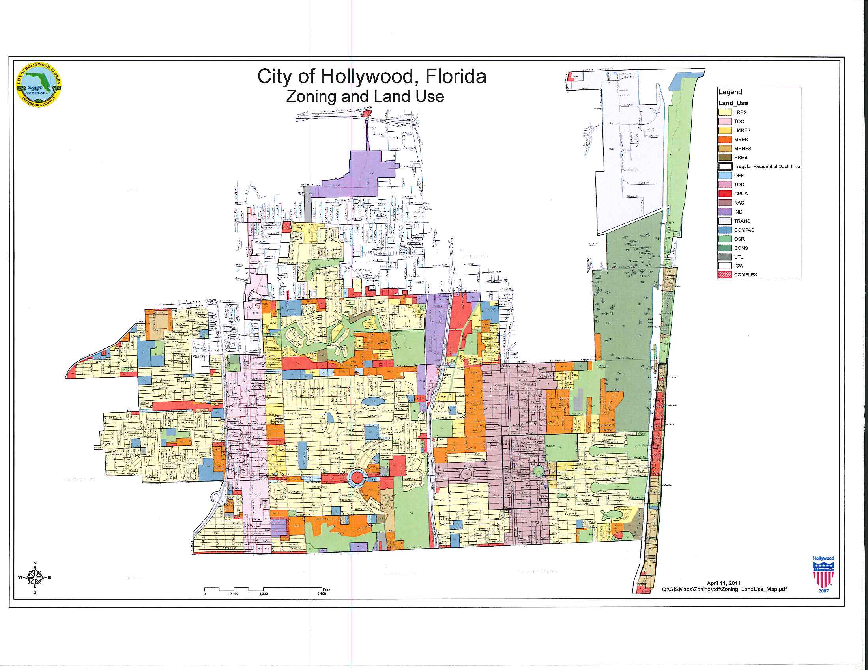
A Tale of Many Cities

Slide 7
A Tale of Many Cities

Slide 8
Definitional Issues
Medical Marijuana Treatment Centers (MMTC)
Medical Marijuana Retail Centers (MMRC)
Persons Associated With The Use - Applicant, Owner, Manager, Employee, Patient, Caregiver, etc.
Forms of Marijuana
Testing Laboratories
Warehousing and Wholesale Storage of Marijuana
All will be impacted, but not necessarily entirely controlled, by Constitutional Amendment and Statute/Rule

Slide 9
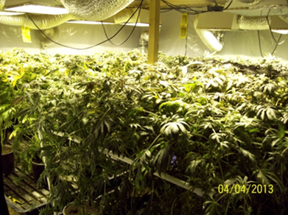
Constitutional Amendment
“Medical Marijuana Treatment Center”
an entity that “acquires, cultivates, possesses, processes (including development or related products such as food, tinctures, aerosols, oils, or ointments), transfers, transports, sells, distributes, dispenses, or administers marijuana, products containing marijuana, related supplies, or educations materials to qualifying patients or their personal caregivers.”

Slide 10
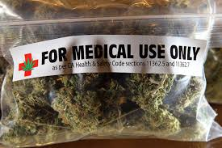
Retail/Dispensary Concept
“Medical Marijuana Retail Centers”
“A retail establishment, licensed by the Florida Department of Health as a “medical marijuana treatment facility,” “medical marijuana treatment center,” “dispensing organization,” “dispensing organization facility” or similar use, that sells and dispenses medical marijuana, but does not engage in any other activity related to preparation, wholesale storage, distribution, transfer, cultivation, or processing of any form of Marijuana or Marijuana product, and does not allow on-site consumption of Marijuana.”

Slide 11
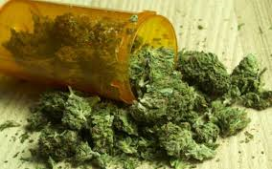
Interaction with Federal Law
The Federal Controlled Substances Act (CSA) prohibits the production, distribution and use of marijuana, for medical or recreational purposes
Both the Amendment and the State legislation apply only to Florida Law
No state statute or law protects against federal prosecution.

Slide 12
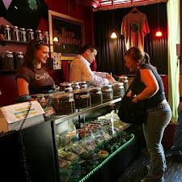
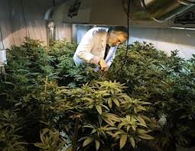
Prohibition or Moratorium
Timing Issues
Scope
Basis in Federal Law or Local Legislative Determination
Indication of Future Regulatory Approach?
Waivers?

Slide 13
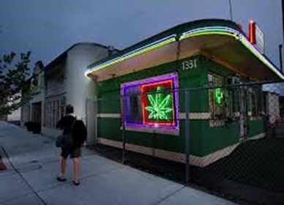
Zoning Regulations
Different Approaches for MMTC vs MMRC
Zoning District
Freestanding or Attached
Bulk Requirements - Standard or Specialized
Parking Standards
Site Plan Required
Drive Through Regulations
Sign Regulation

Slide 14
Zoning Regulations
Spacing Requirements
From Protected Uses or From Each Other
Measurement Rules
Effect of Later Arriving Protected Uses
Ability To Vary
State Context for Spacing

Slide 15
Zoning Regulations
Conditional Use
Transferability of Applicant or Location
Duration
Binding Property Owner and Tenant
Special Notices to Surrounding Property Owners and Tenants
Suspension or Revocation

Slide 16
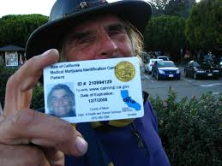
Business Regulations
Medical Marijuana Permit or License for All Marijuana Uses
Detailed Information, History and Level II Background Checks on All Persons Involved in Business
City ID Cards with Photos for Such Persons - Not Transferable
Copies of All State Paperwork, Which Must Remain Current and Valid At All Times
License and Application Fees – Not Taxes
Standards for Rejection or Revocation and Possibility of Re-Application
Term and Renewal or Expiration
License Not Transferable

Slide 17
Business Regulations
Standards that may vary by use:
Hours of Operation
Onsite Storage Beyond Inventory Needed for MMRC
Ability to Grow Onsite
Required Compliance with All Laws – Zoning, City Code, State, Federal
Outdoor Sales Activity
On Premise Consumption of Marijuana
Alcohol License or Consumption

Slide 18
Business Regulations
Security Plan and CPTED Survey, Public Safety and Fire Issues
Operations plan
Video surveillance
Display and storage security planning requirements
Cash storage and protection planning requirements
Alarm system
Implementation of Police Crime Prevention Through Environmental Design Review (CPTED) standards
Armed security personnel on-site during business hours

Slide 19
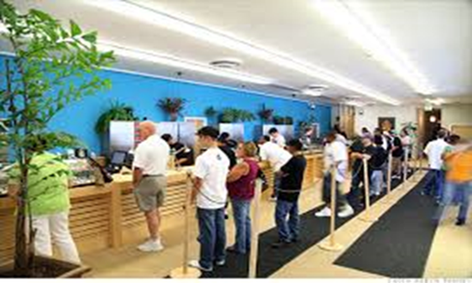
Business Regulations
Environmental Controls - Odor, Air Quality, etc.
No Tourists/Gawkers – Only Those Authorized to be On Premises
Anti Loitering and Lines - Pedestrian and Vehicular
Designated Ombudsman for Neighborhood Issues
No Employment of or Access To Minors Other Than Minor Patient with Guardian
Control of Garbage

Slide 20
Planning for Medical Marijuana
Questions?
Susan L. Trevarthen, Esq., FAICP
Weiss Serota Helfman Cole Bierman & Popok, PL

